Slide 1

Terraform

Slide 2
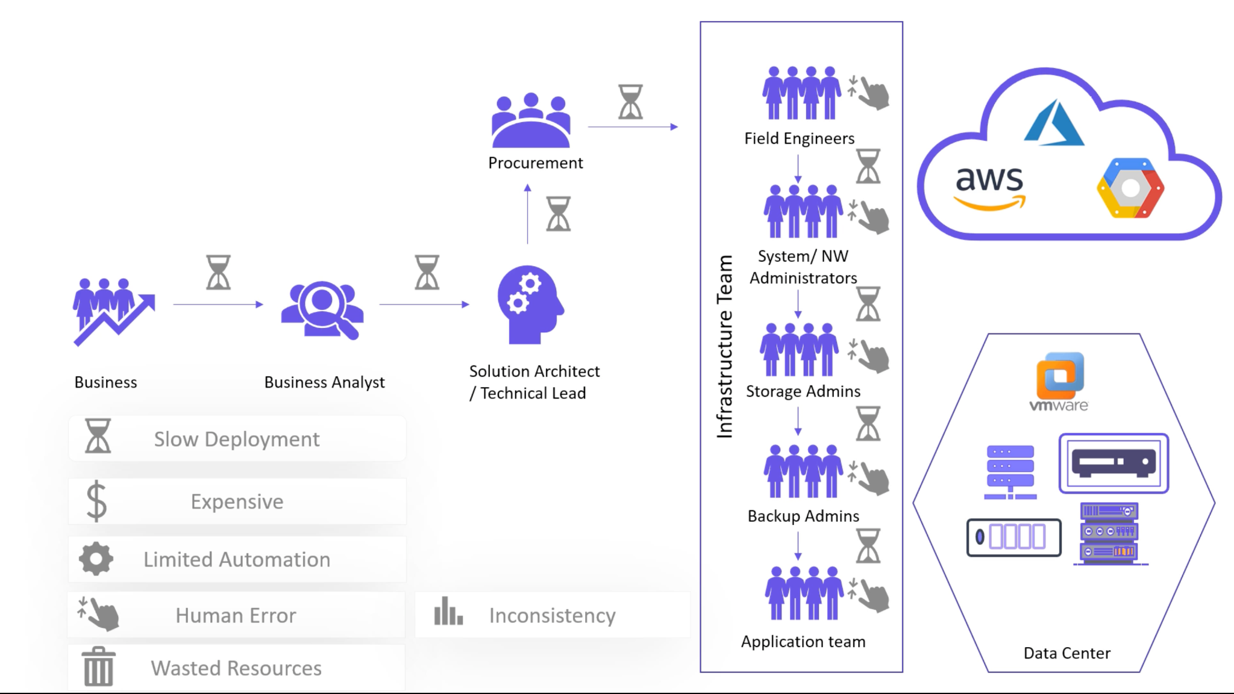
Traditional IT Infrastructure Challenges

Slide 3
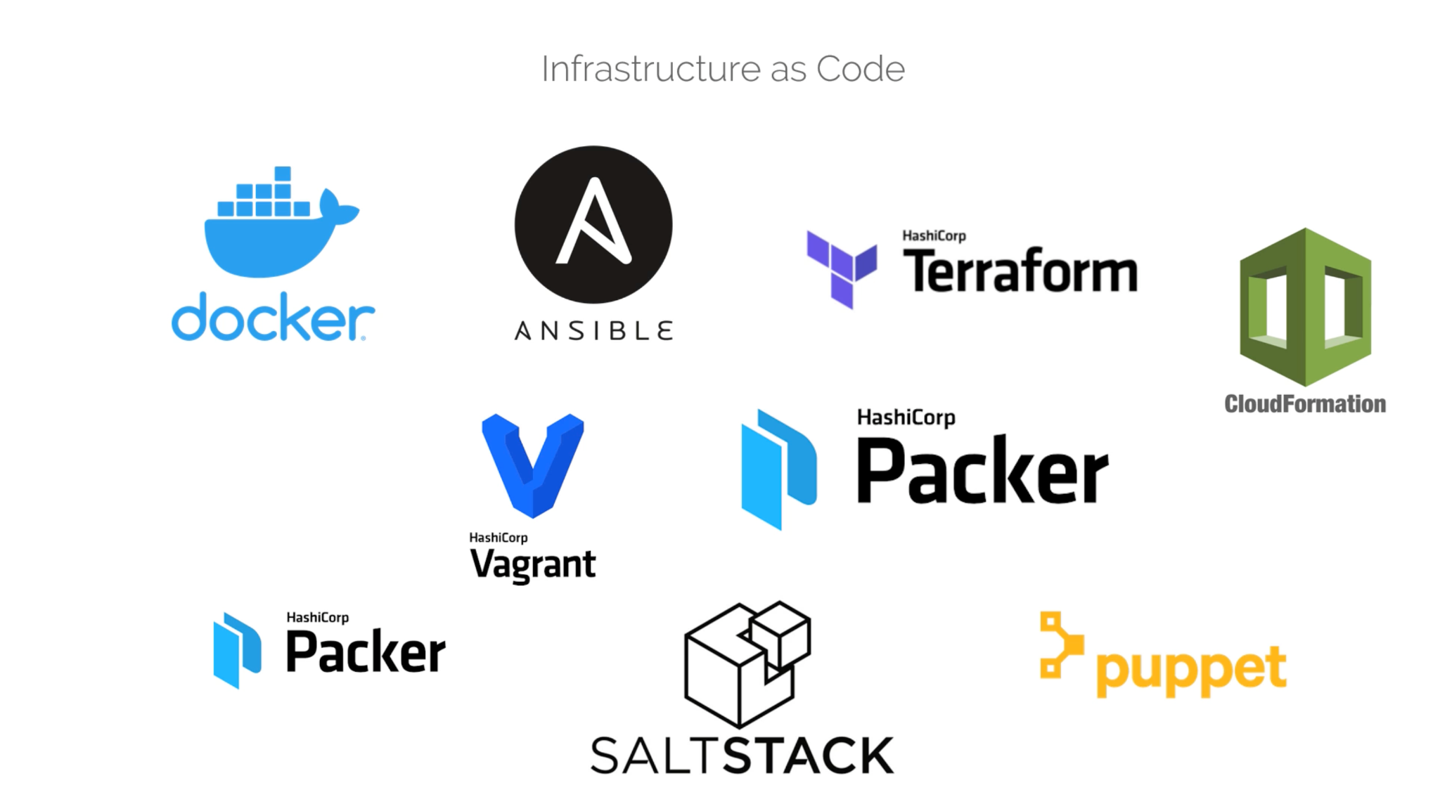
Infrastructure as Code

Slide 4
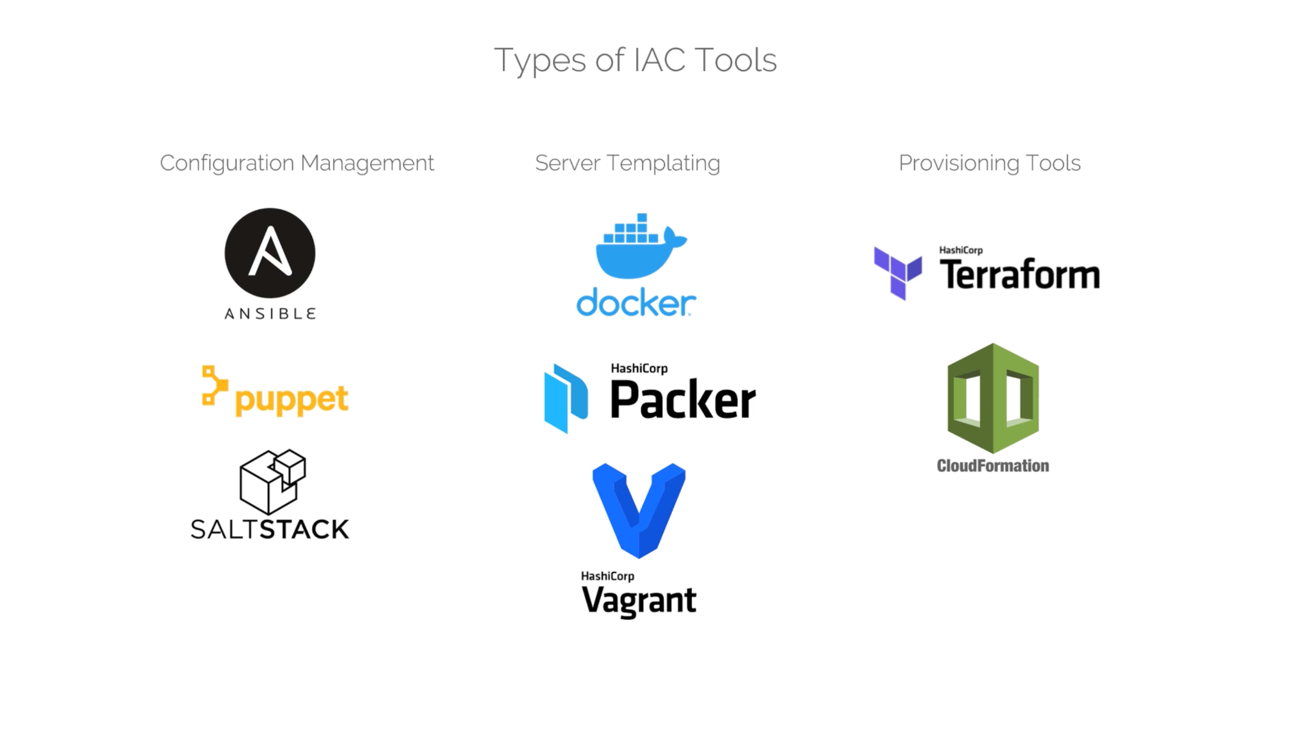
Types of IAC Tools

Slide 5
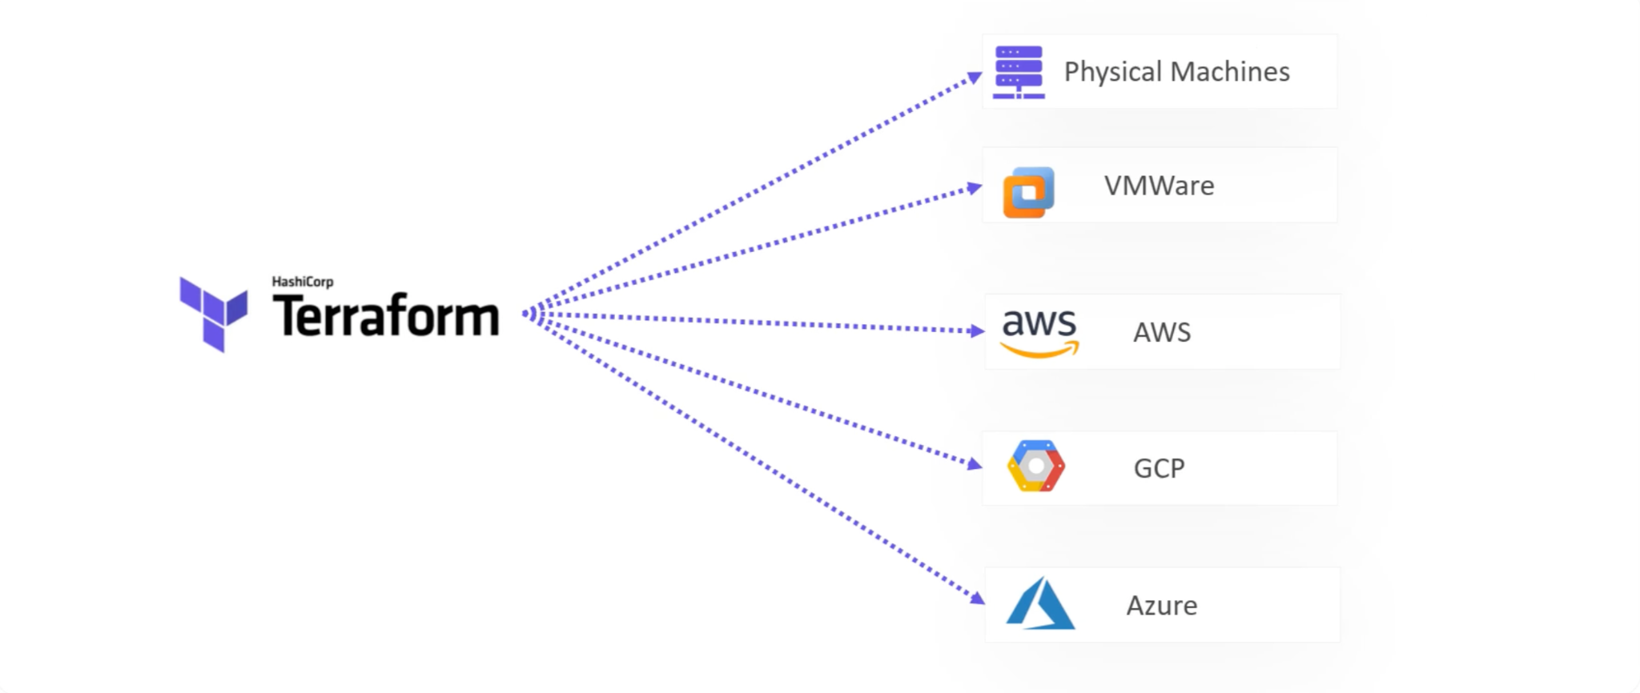
Why Terraform?

Slide 6
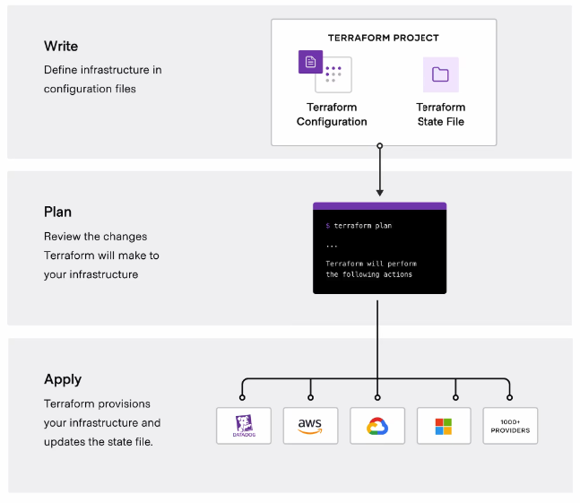
Why Terraform?

Slide 7
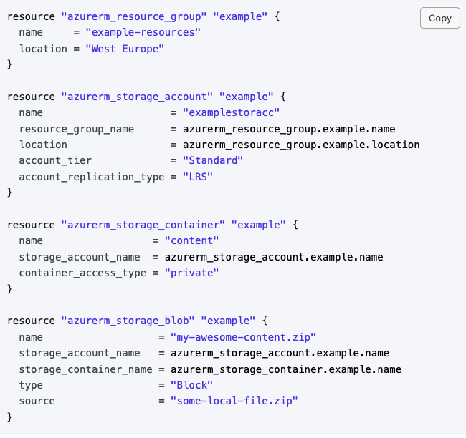
Why Terraform?
Infrastructure as Code (IaC)
Declarative Configuration and Version Control
Multi-Cloud Support
State Management
Integration with CI/CD
Provisioning and Management
Modularity and Reusability

Slide 8
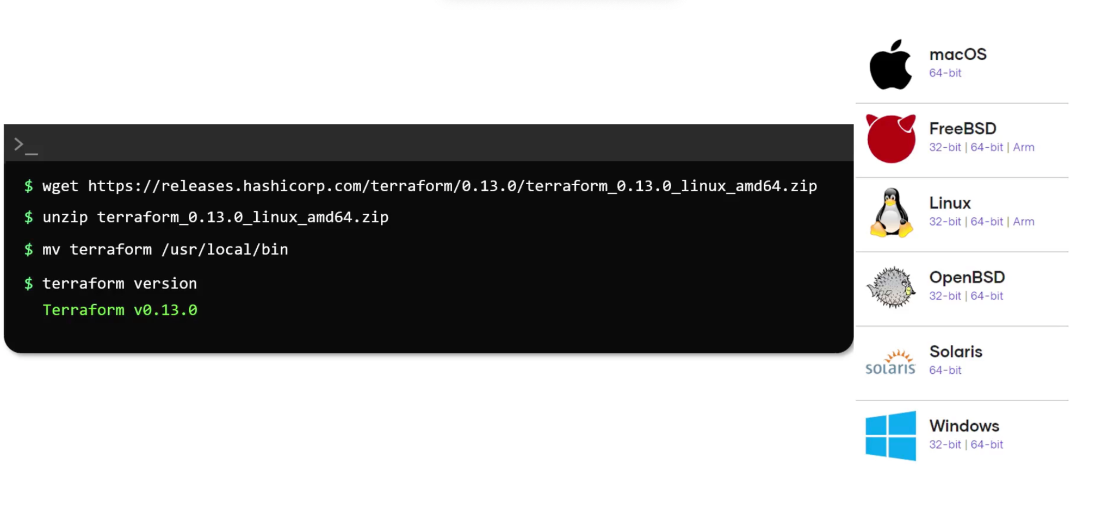
Installing Terraform

Slide 9
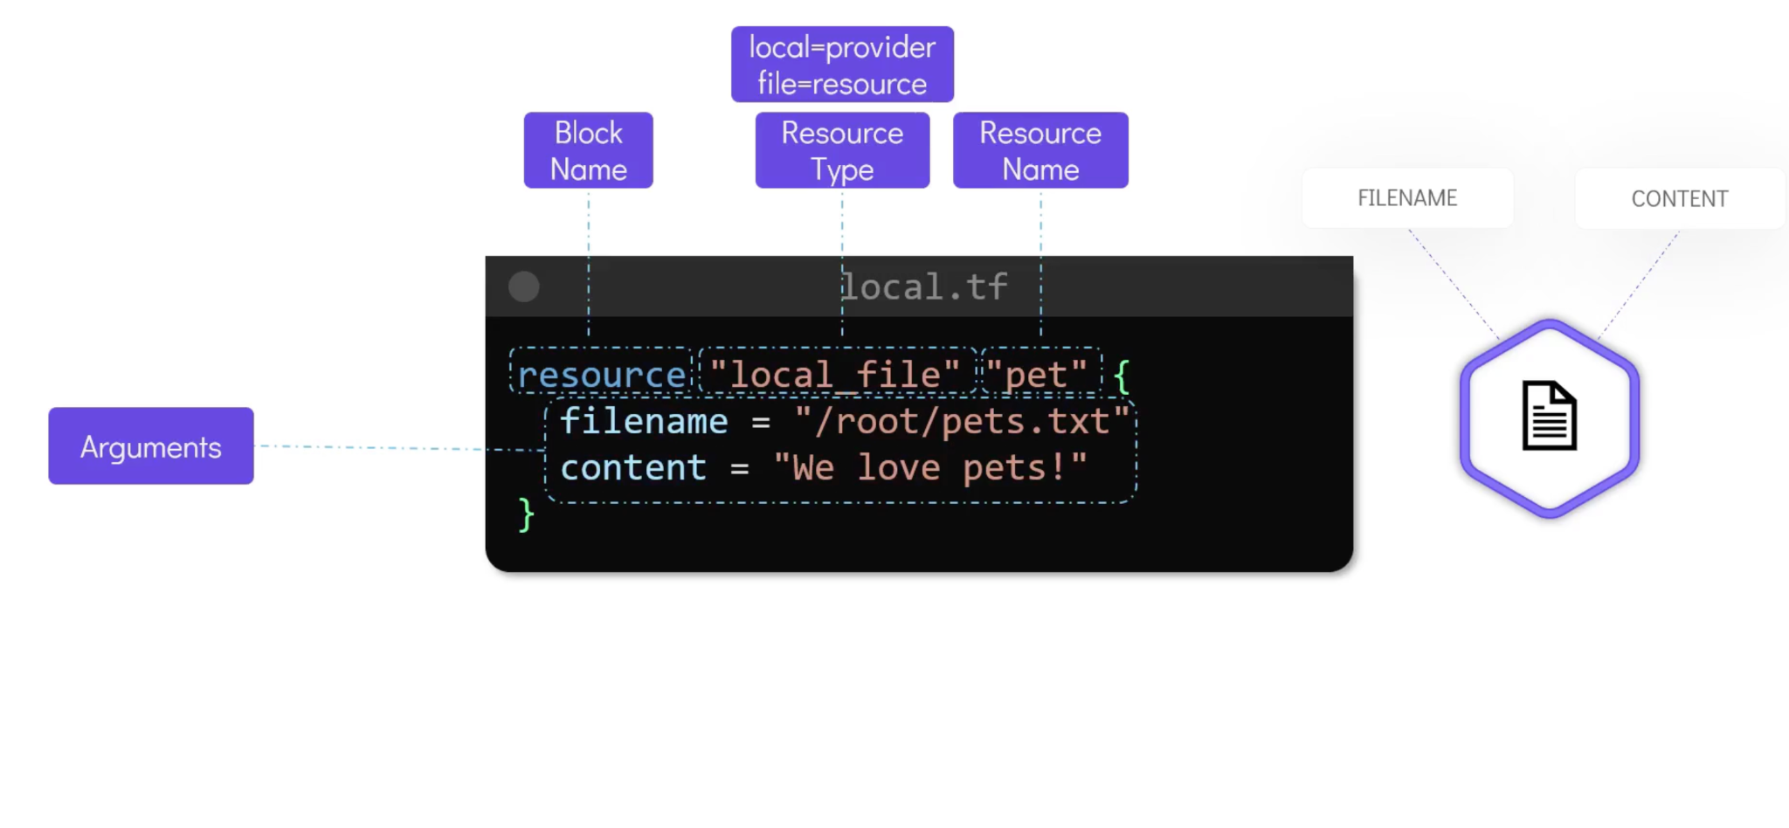
HashiCorp Configuration Language (HCL) Basics

Slide 10
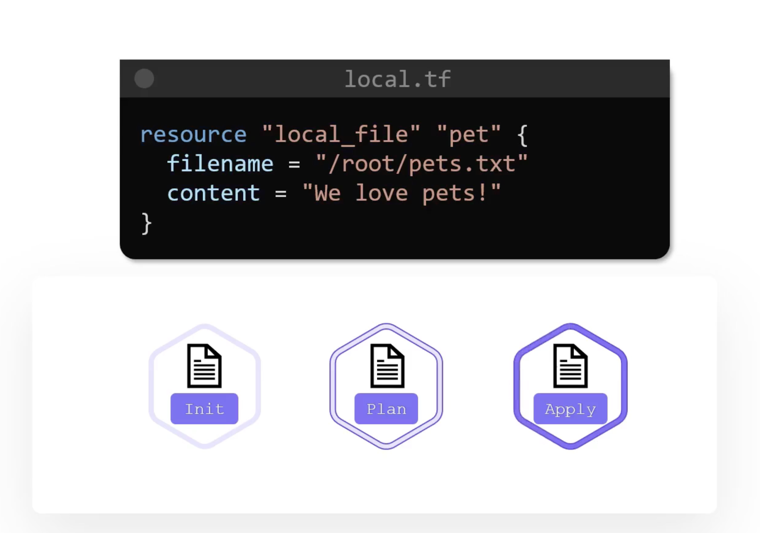
HashiCorp Configuration Language (HCL) Basics

Slide 11
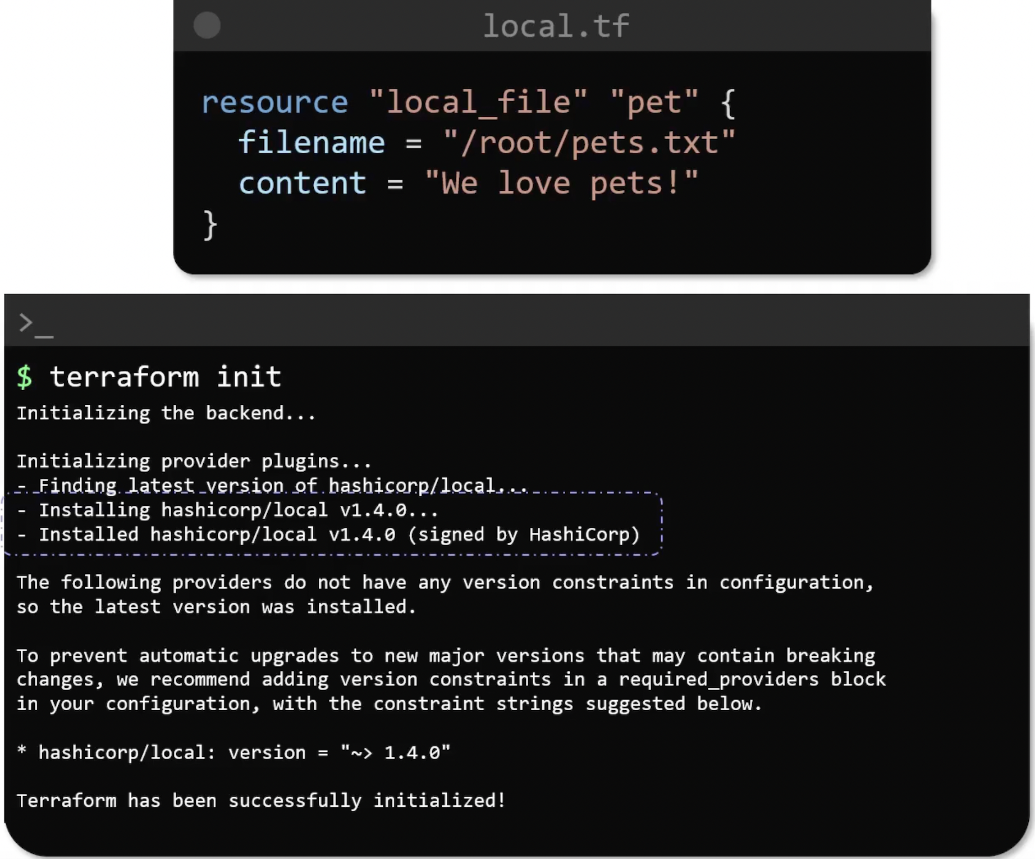
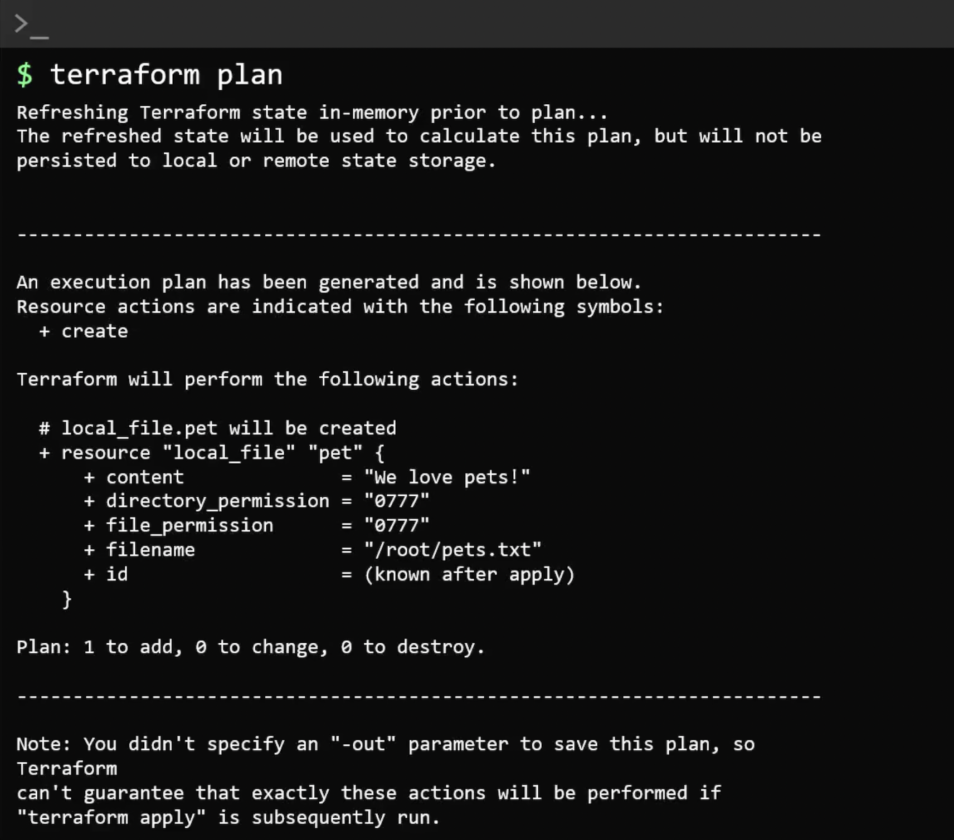
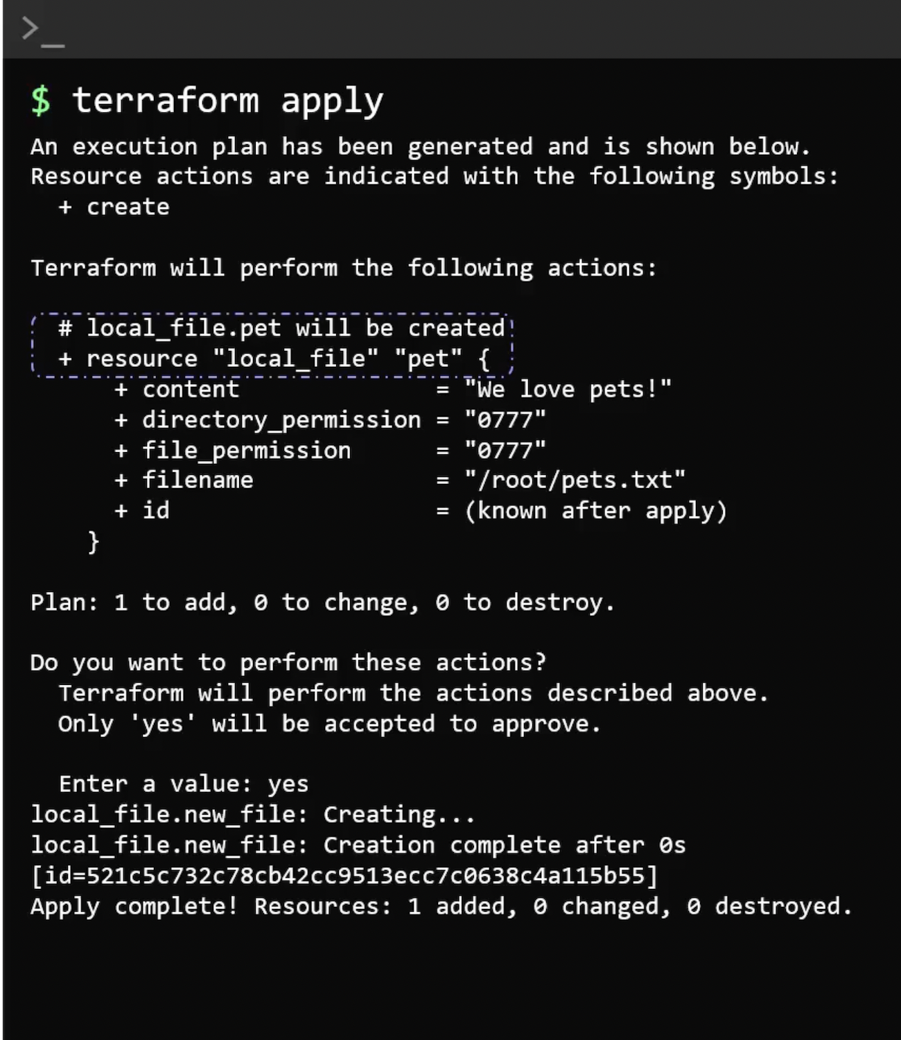
HashiCorp Configuration Language (HCL) Basics

Slide 12
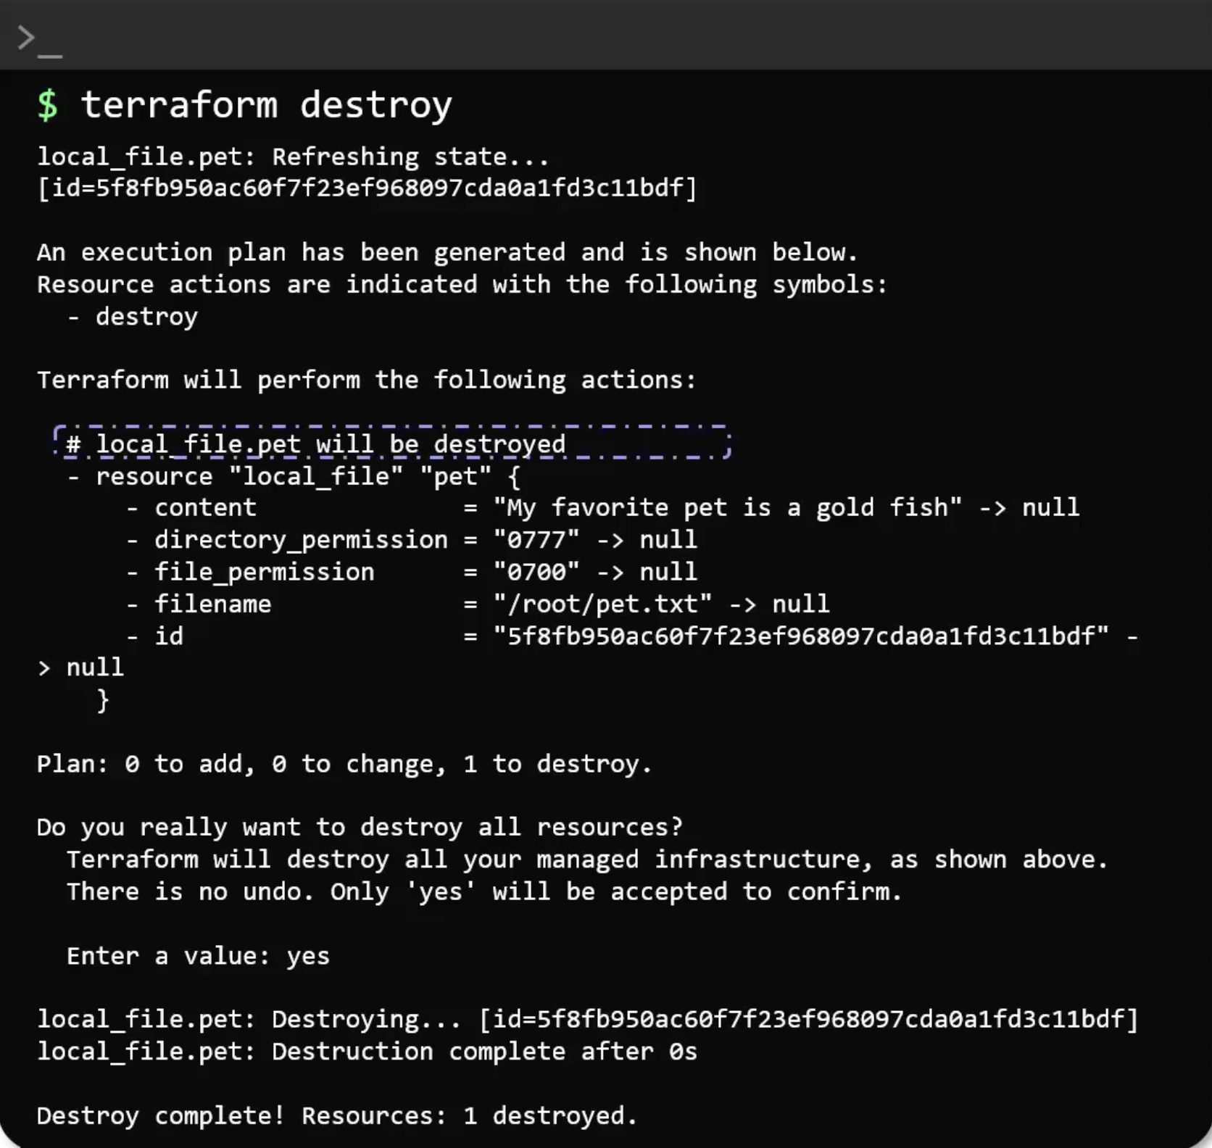
HashiCorp Configuration Language (HCL) Basics

Slide 13
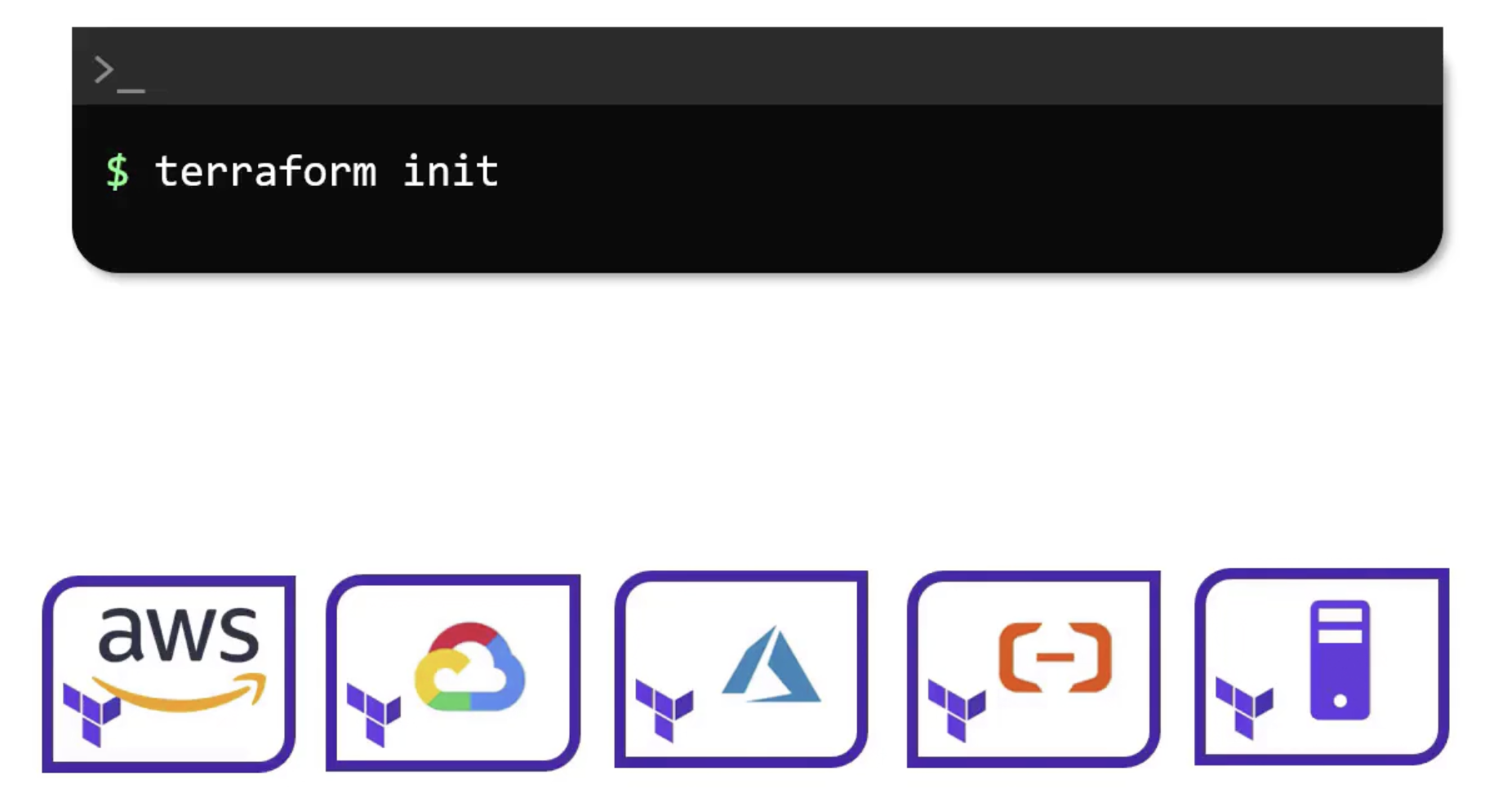
Using Terraform Providers

Slide 14
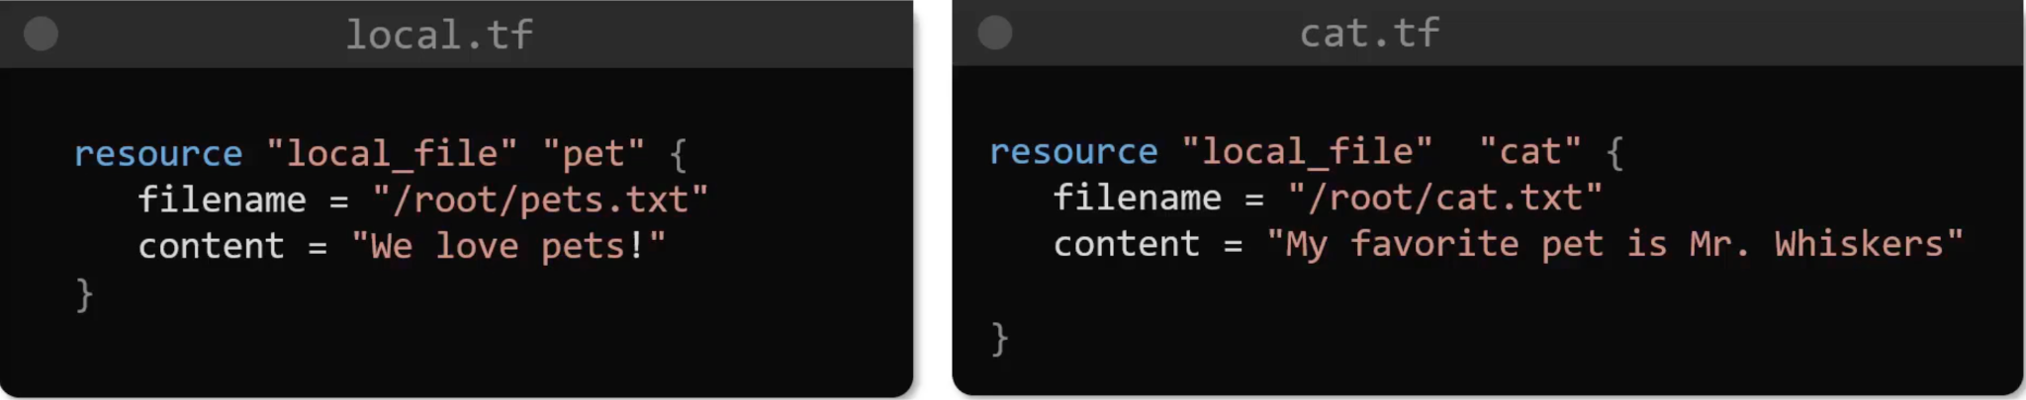
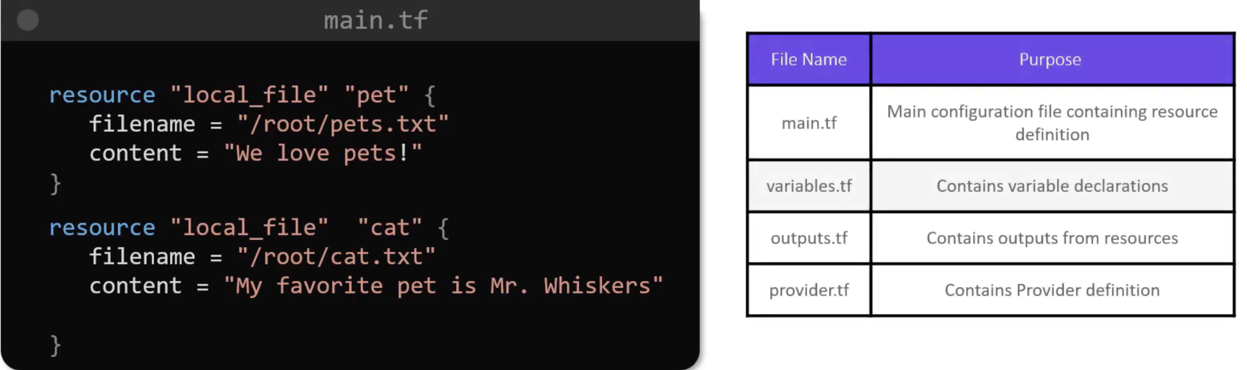
Configuration Directory

Slide 15
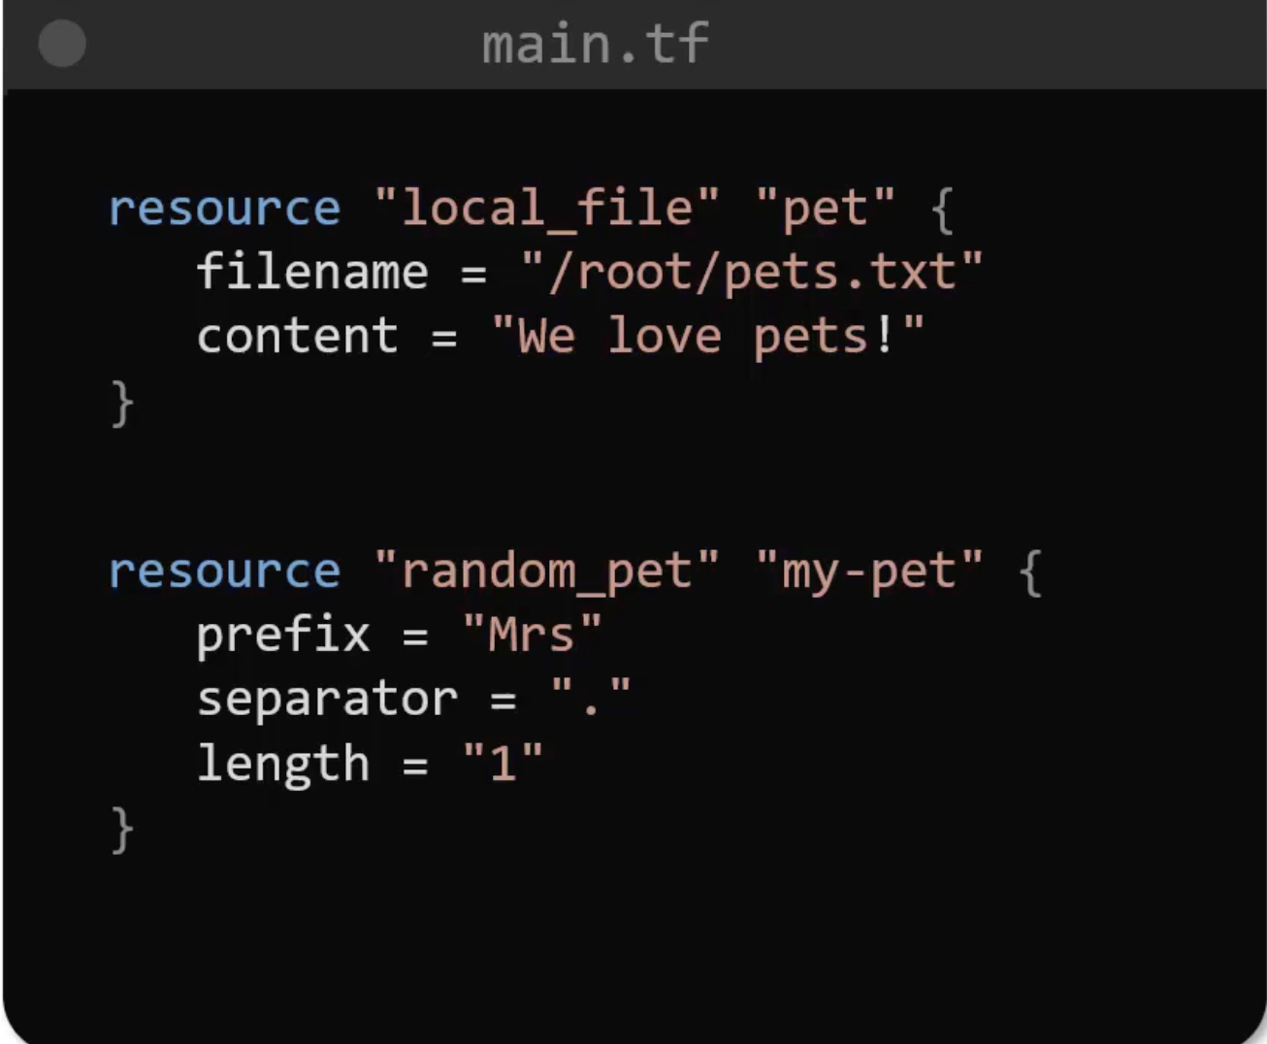
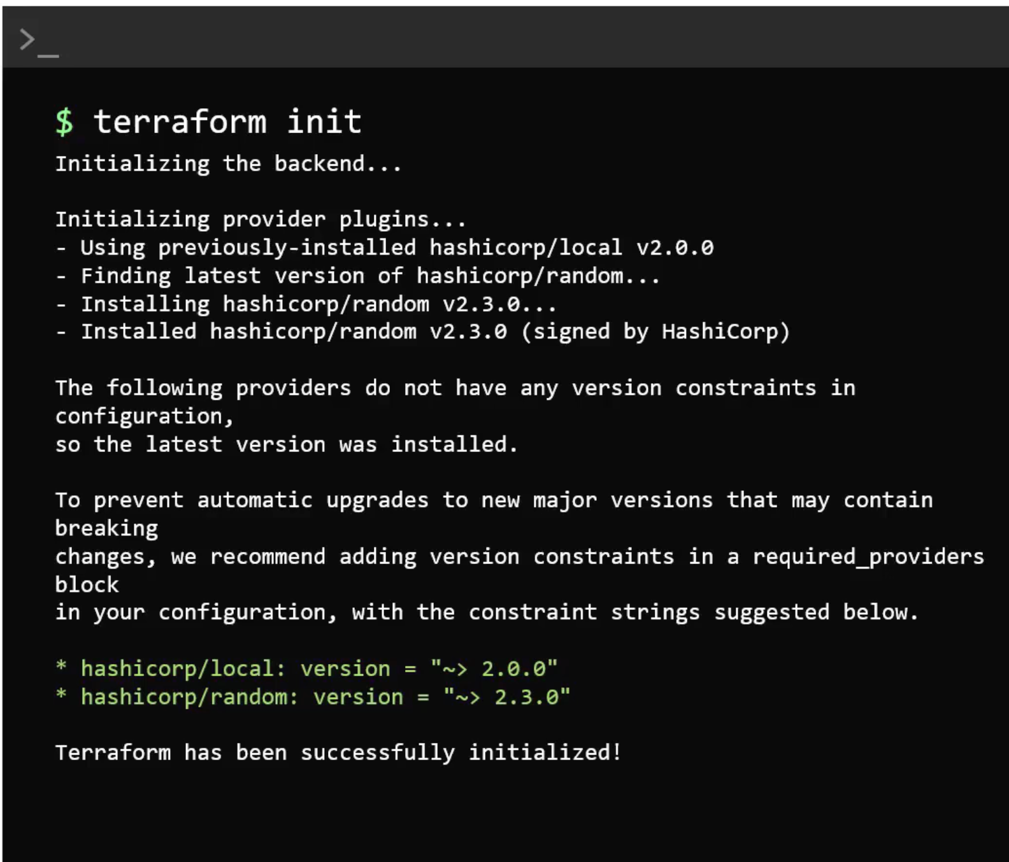
Multiple Providers

Slide 16
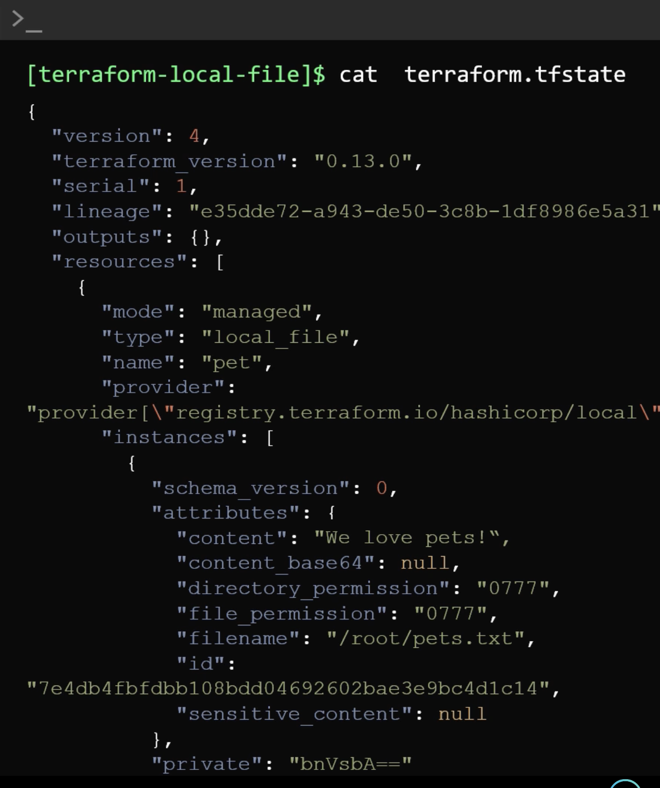
Terraform State

Slide 17
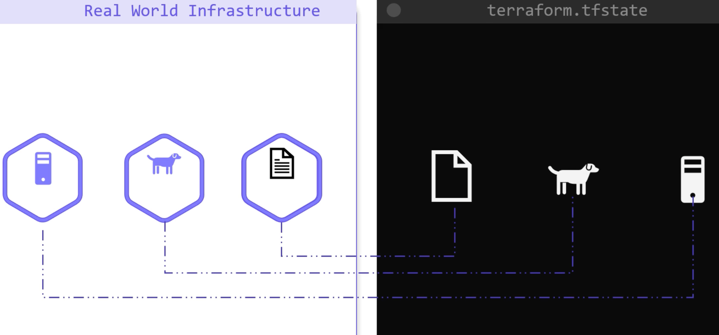
Terraform State

Slide 18
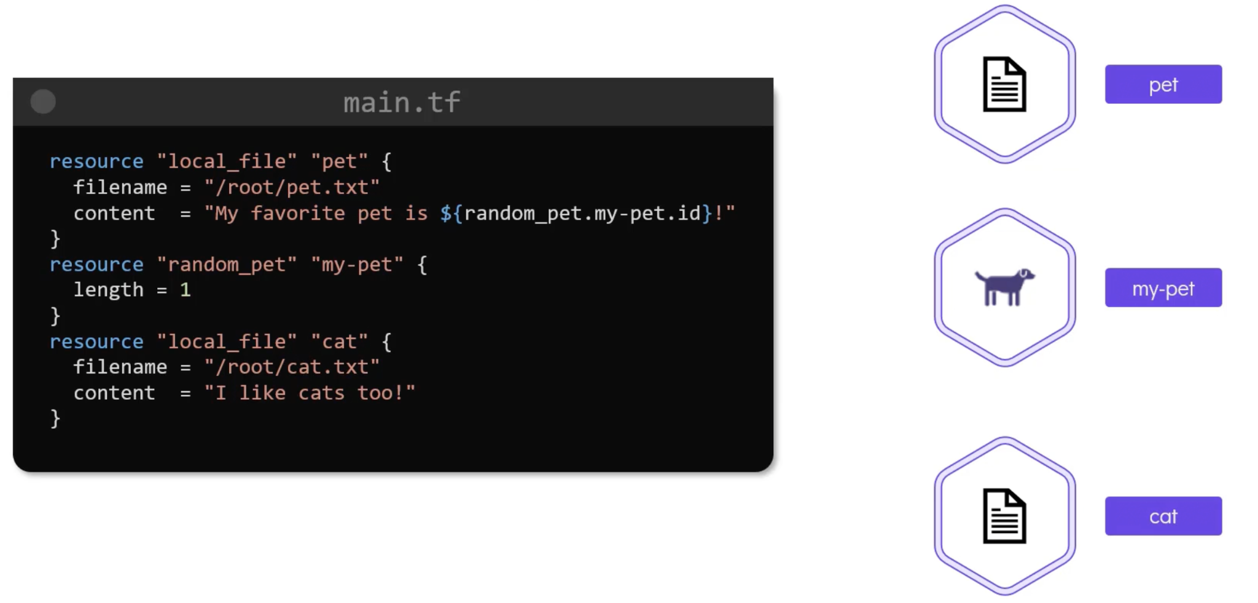
Purpose of State
Tracking Metadata

Slide 19
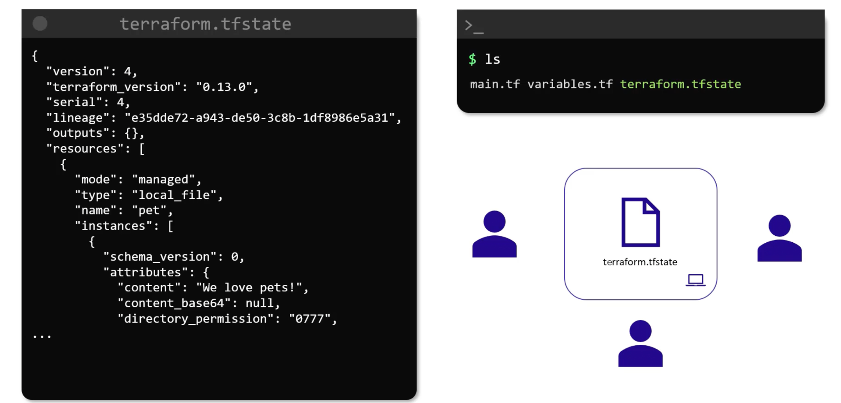
Purpose of State
Collaboration

Slide 20
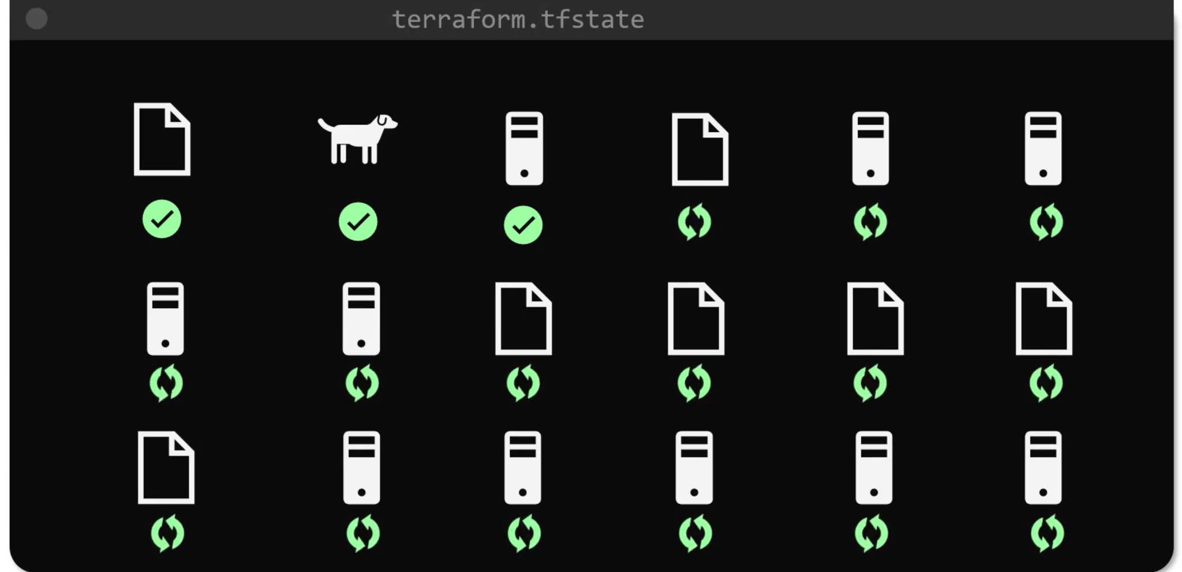
Purpose of State
Performance

Slide 21
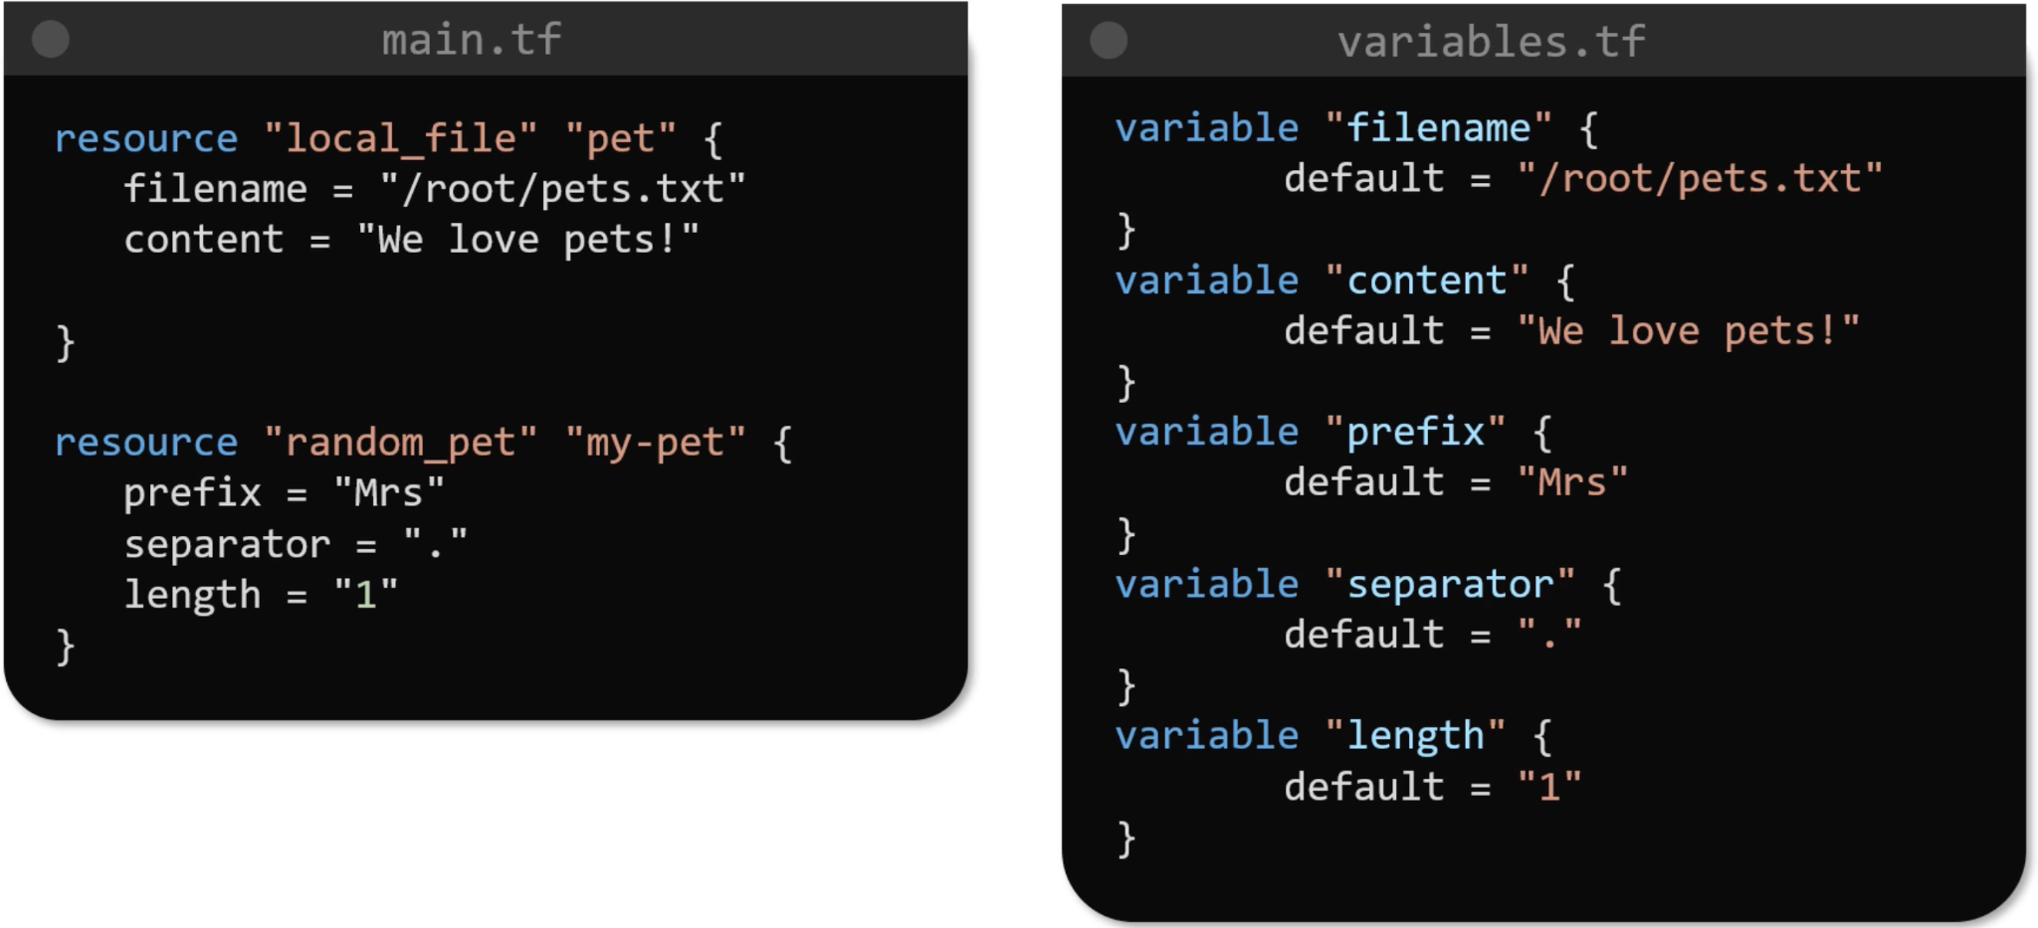
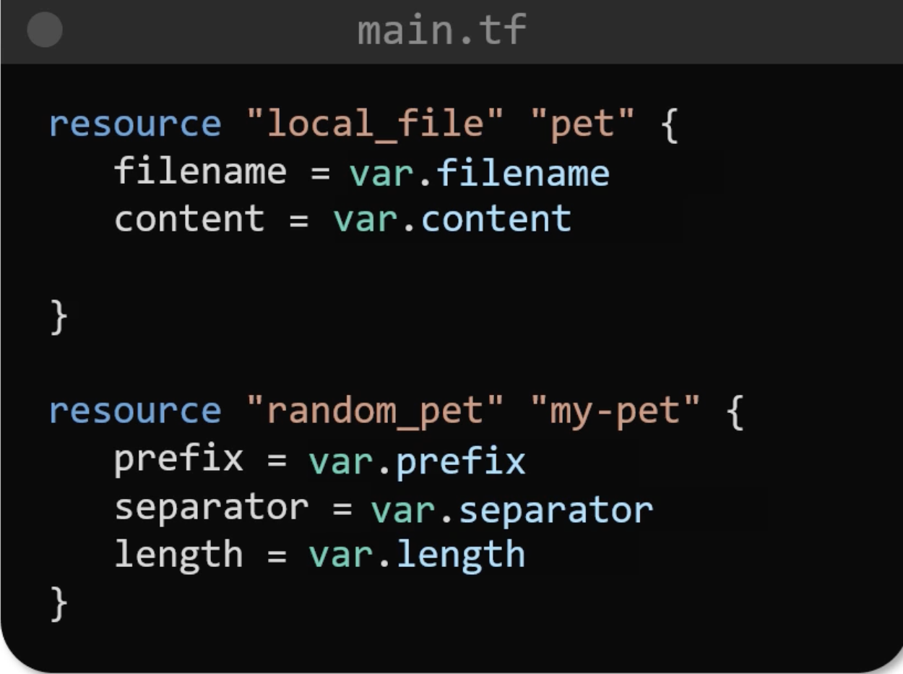
Using Input Variables

Slide 22
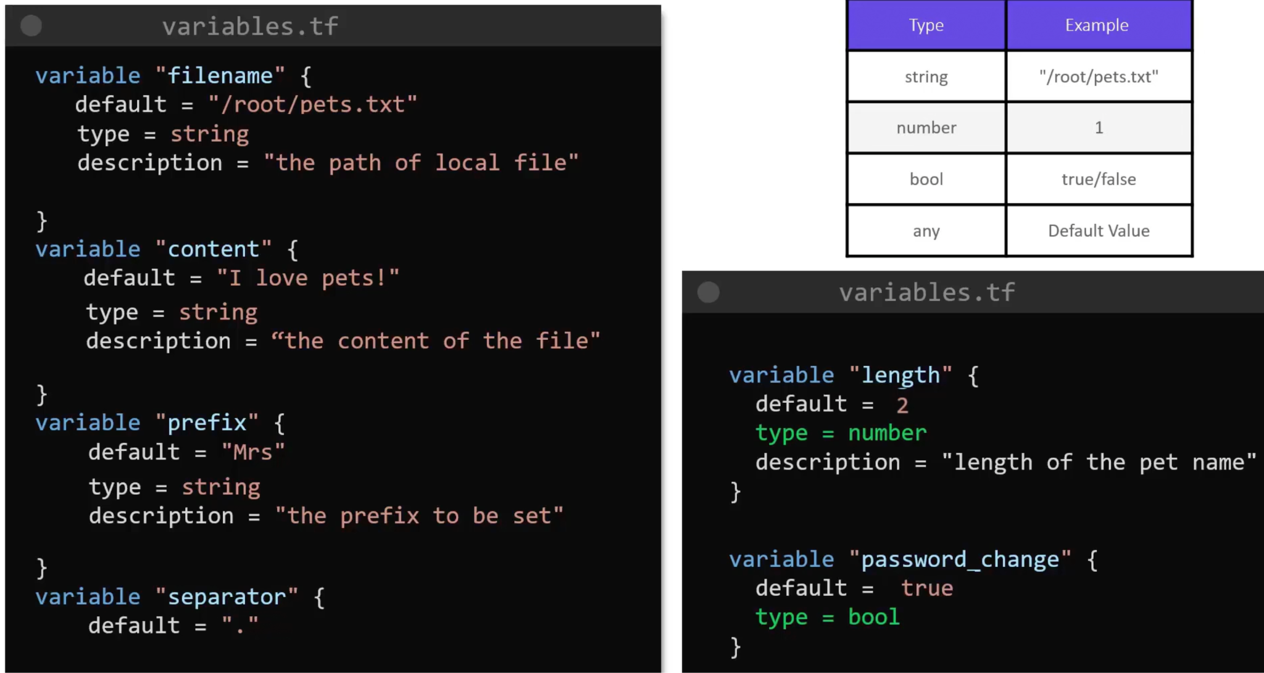
Understanding the Variable Block
String, Number, Bool, Any

Slide 23
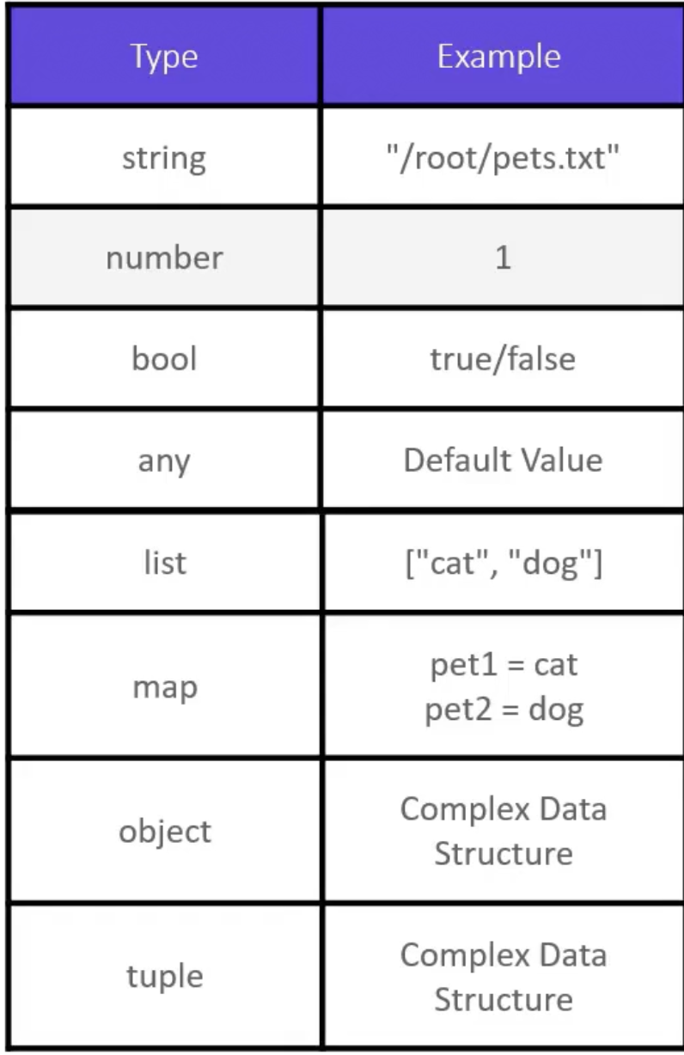
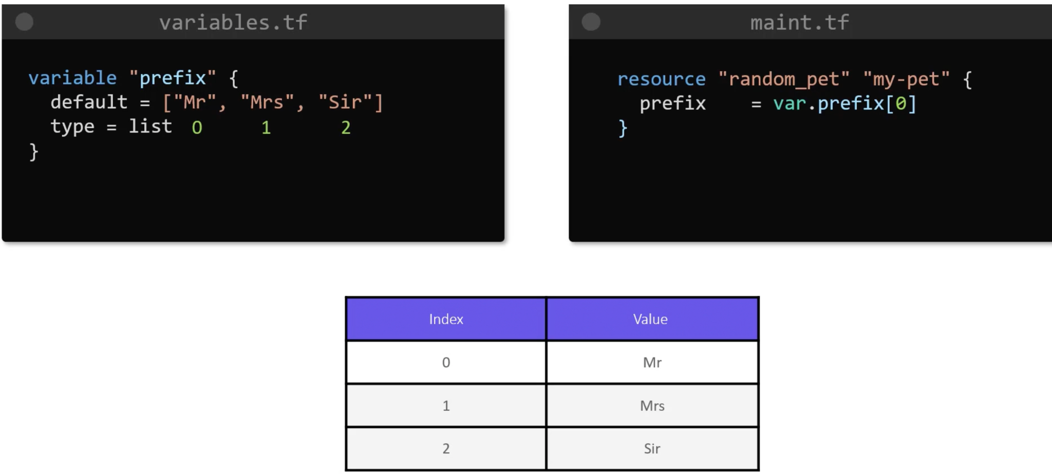
Understanding the Variable Block
List

Slide 24
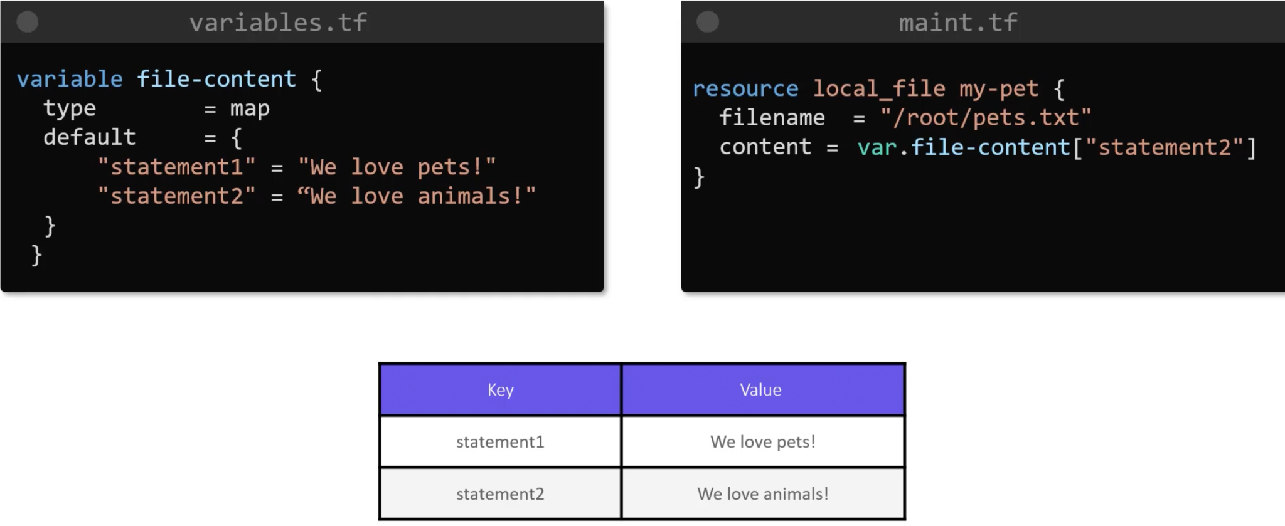
Understanding the Variable Block
Map

Slide 25
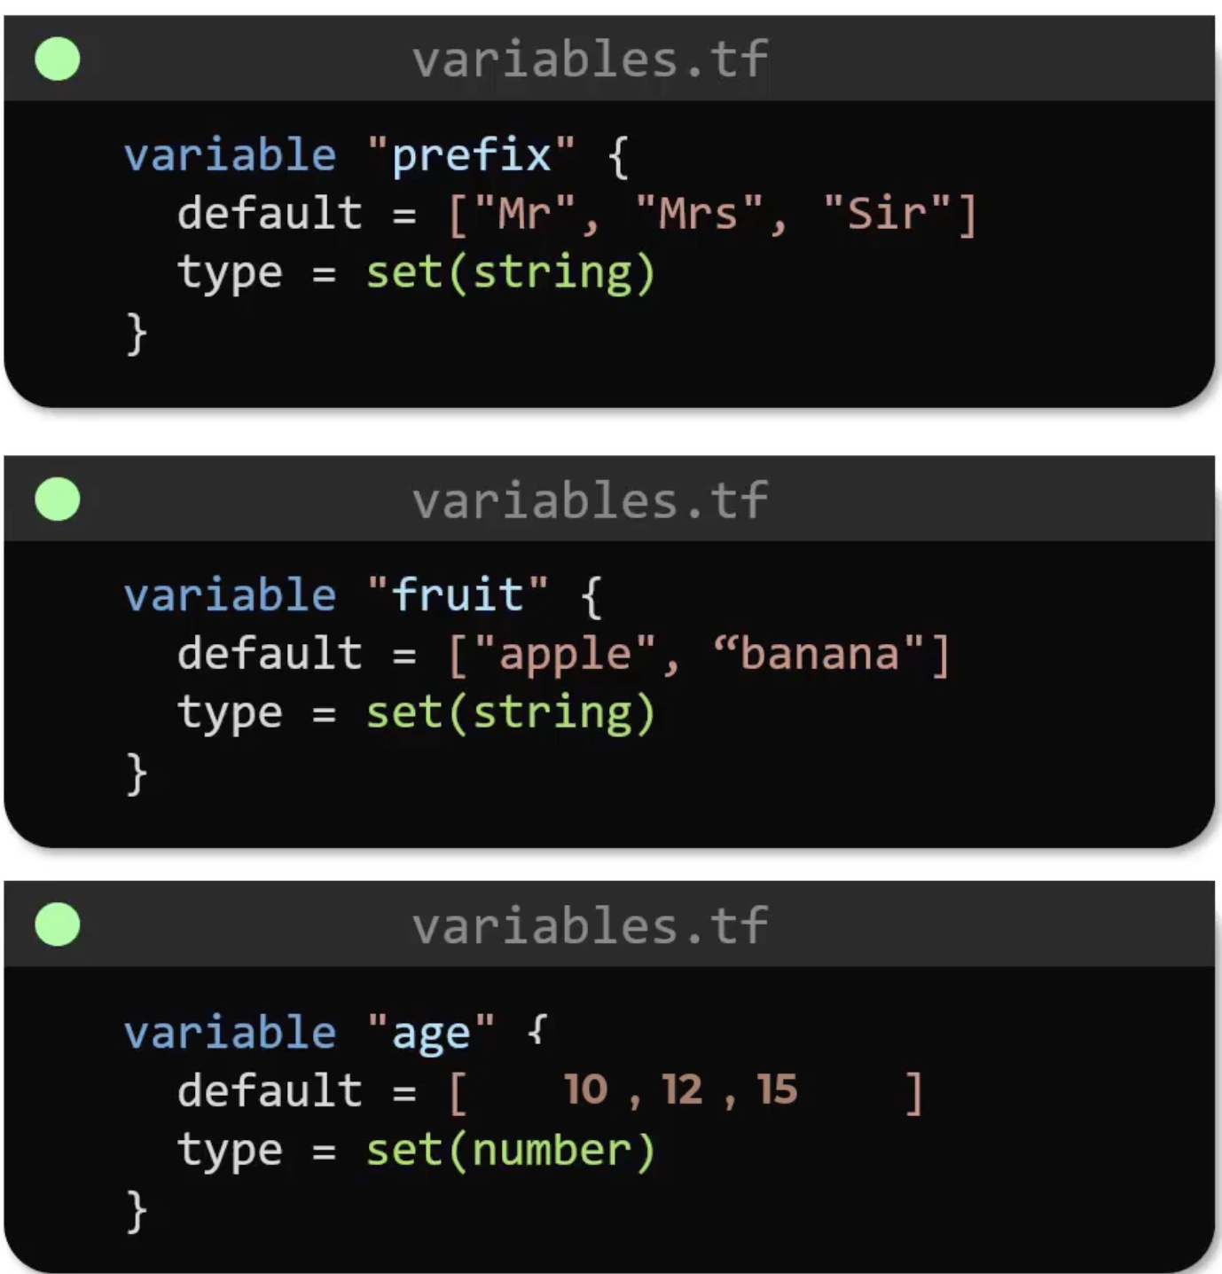
Understanding the Variable Block
Set

Slide 26
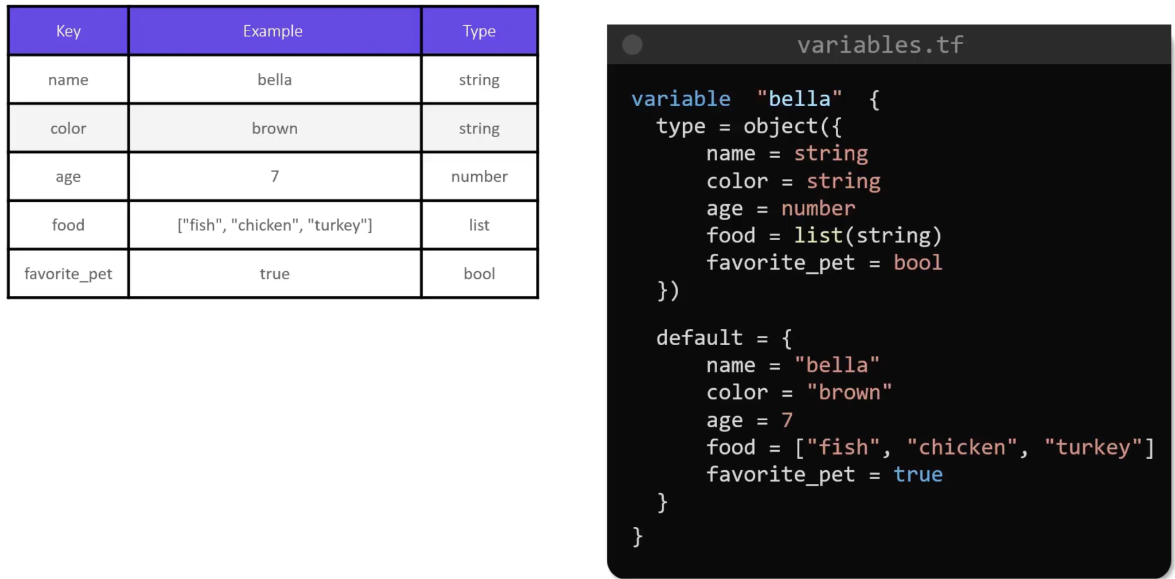
Understanding the Variable Block
Object

Slide 27
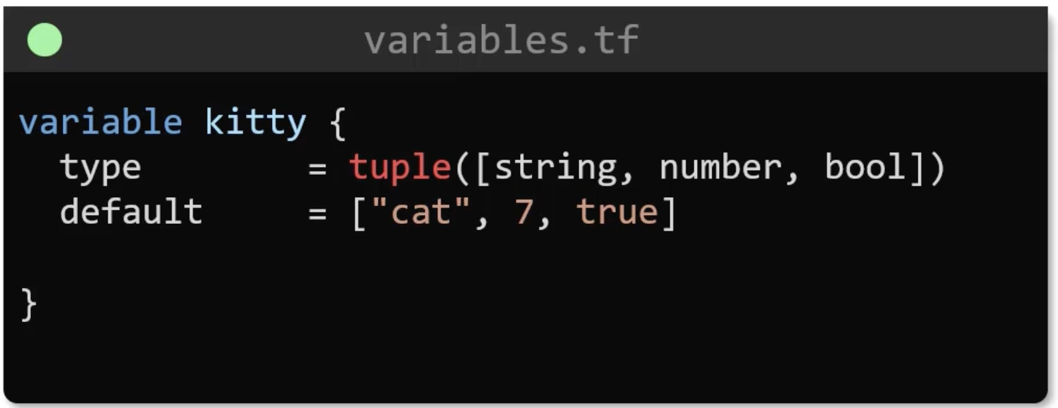
Understanding the Variable Block
Tuples

Slide 28
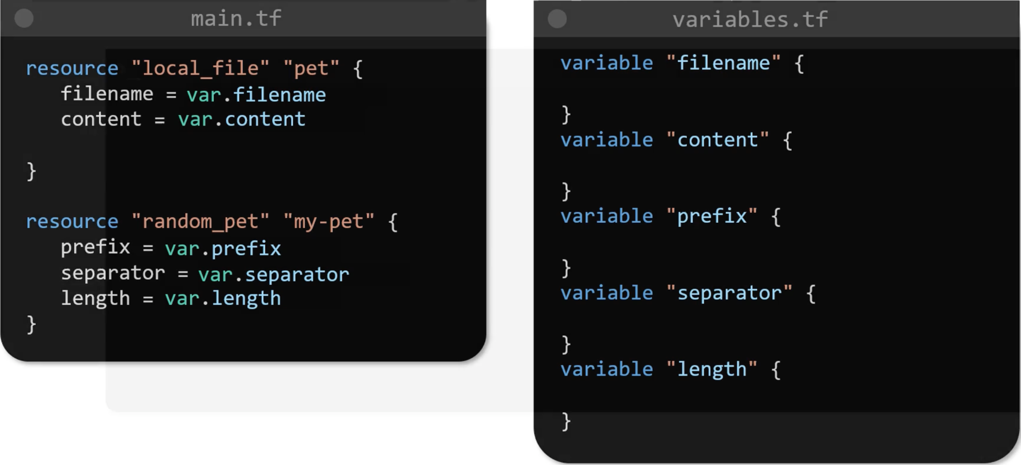
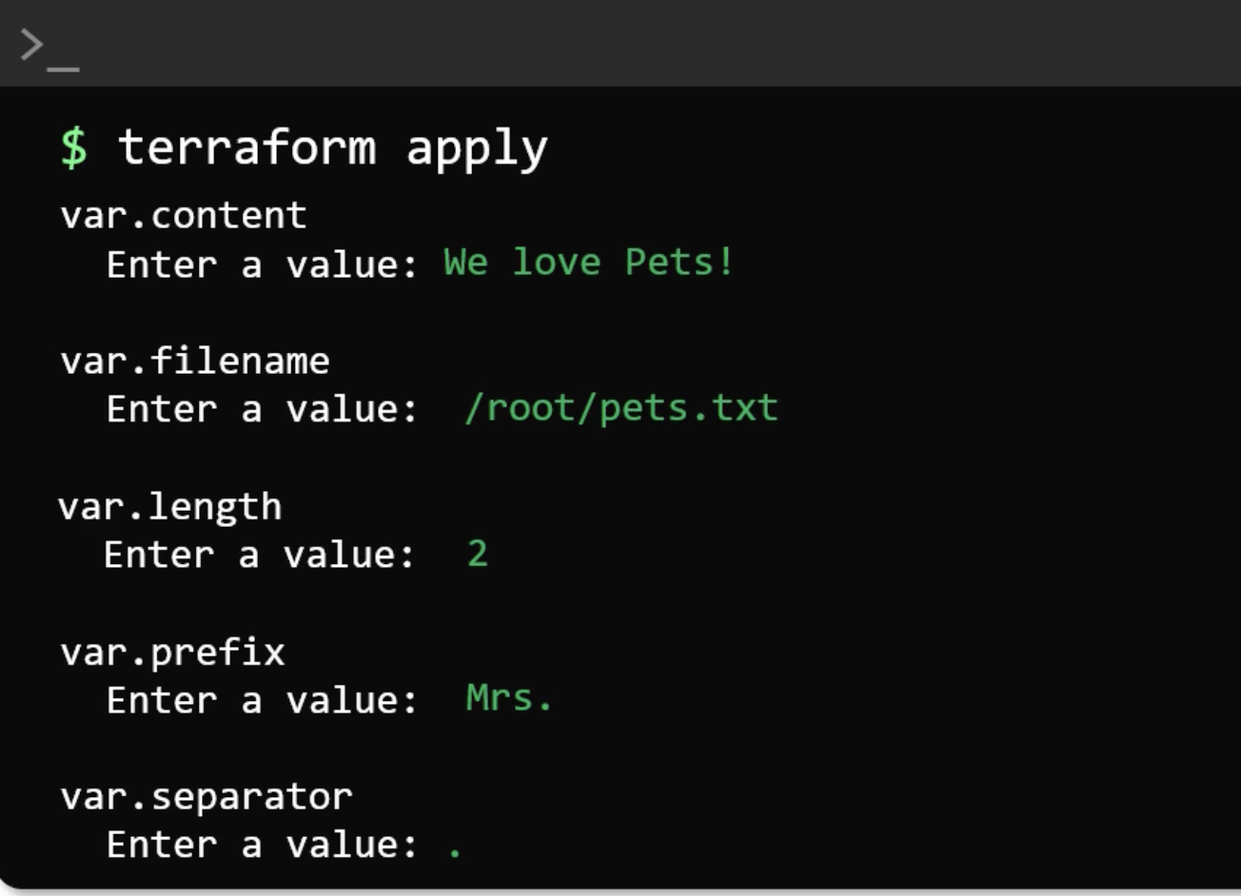
Using Variables in Terraform
Interactive Mode

Slide 29
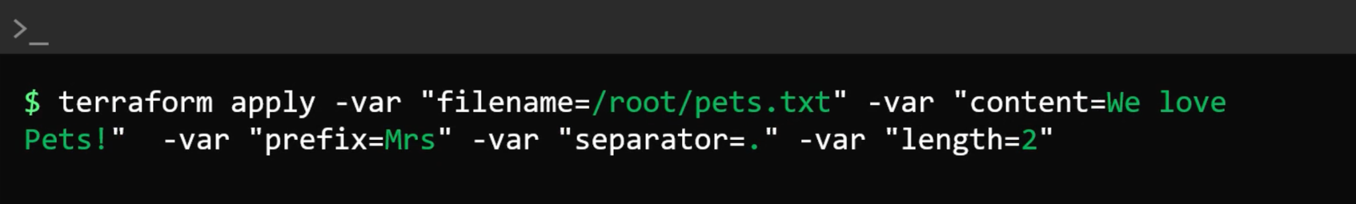
Using Variables in Terraform
Command Line Flags

Slide 30
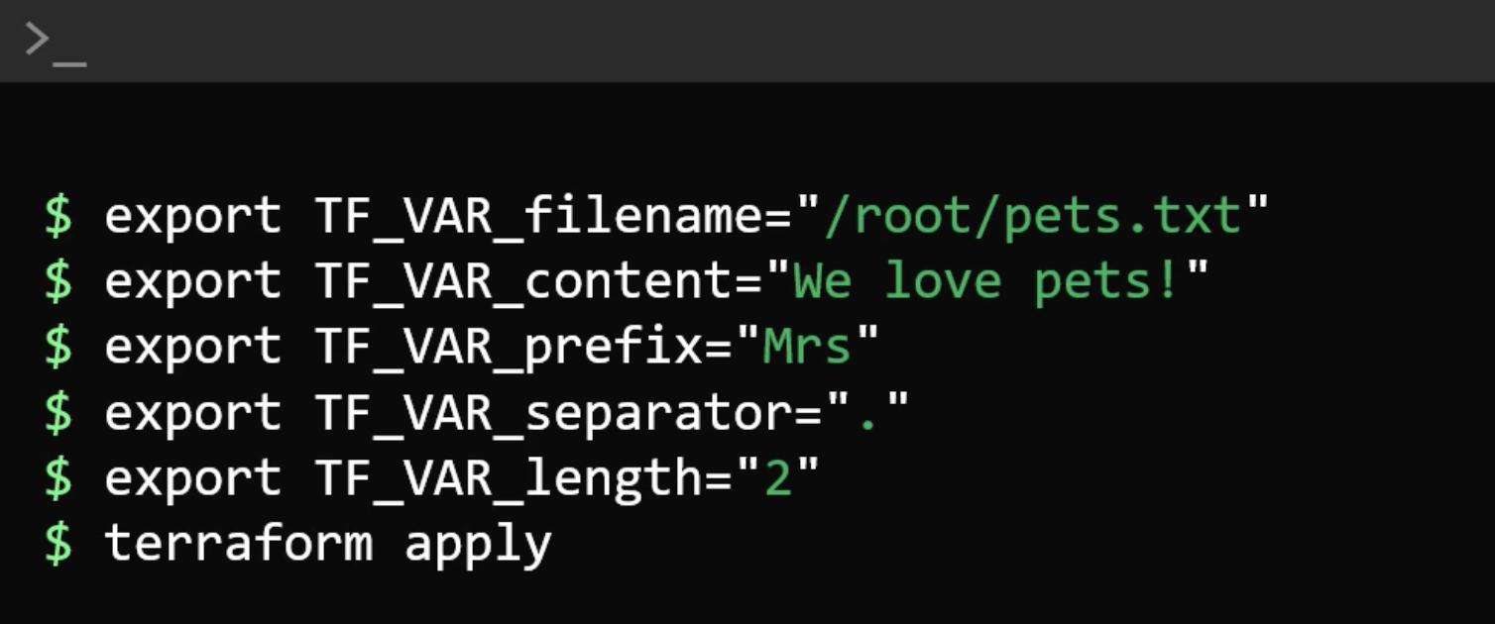
Using Variables in Terraform
Environment Variables

Slide 31
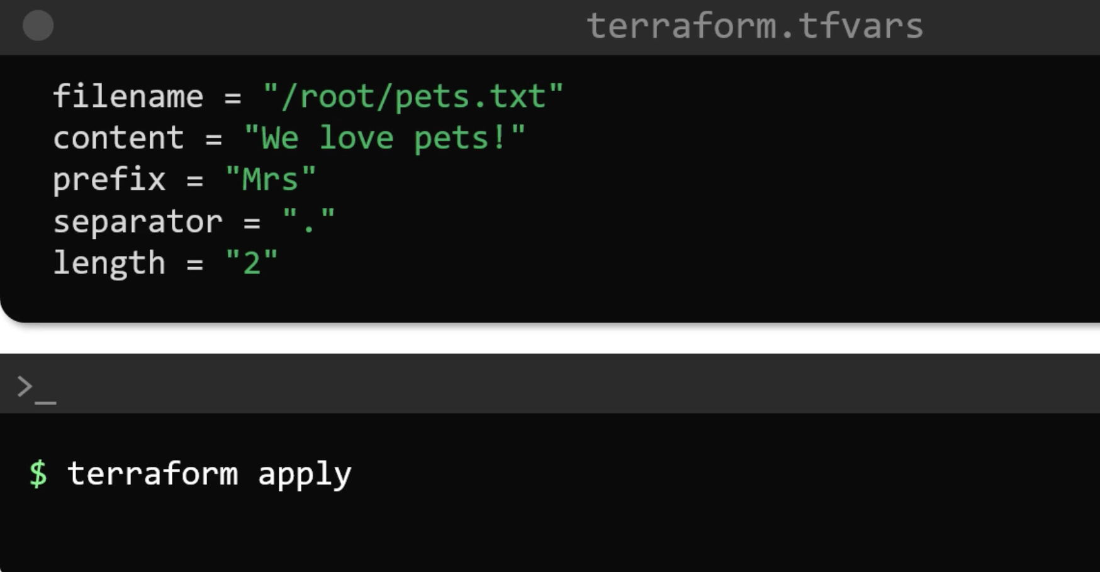
Using Variables in Terraform
Variable Definition Files

Slide 32
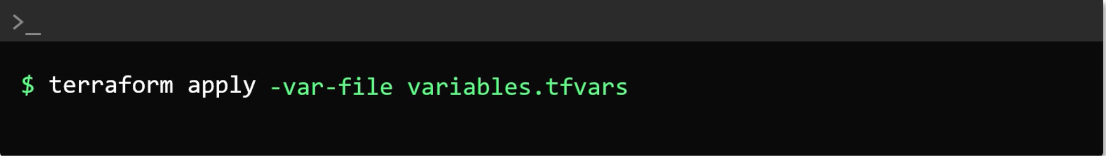
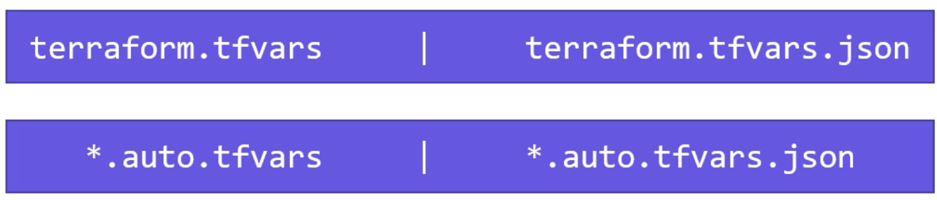
Using Variables in Terraform
Automatically Loaded

Slide 33
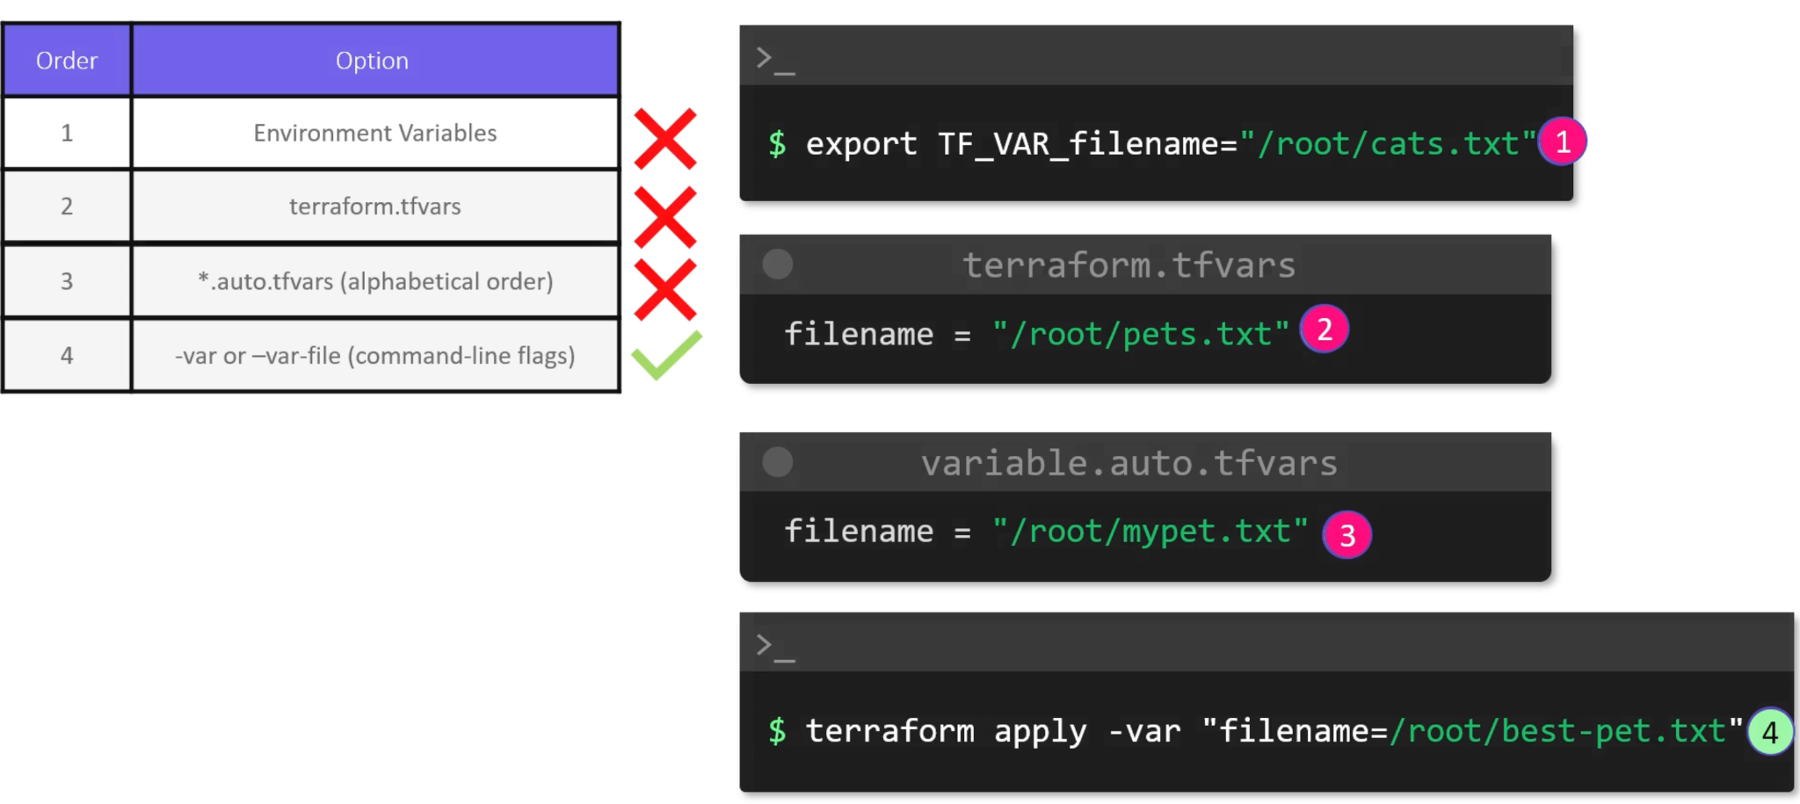
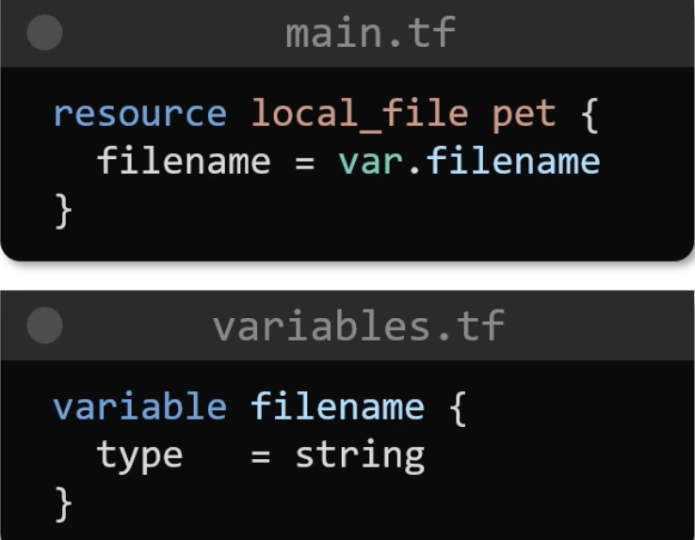
Using Variables in Terraform
Variable Definition Precedence

Slide 34
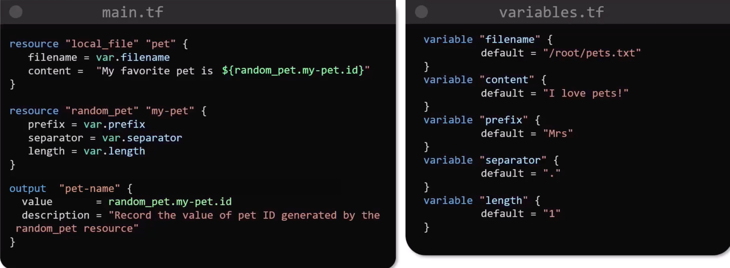
Output Variables

Slide 35
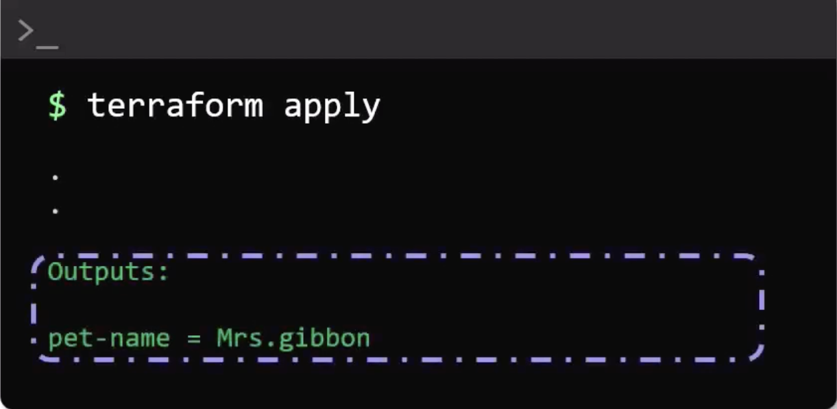
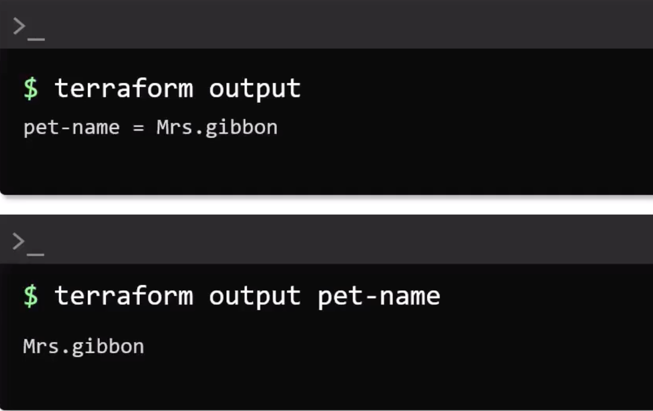
Output Variables

Slide 36
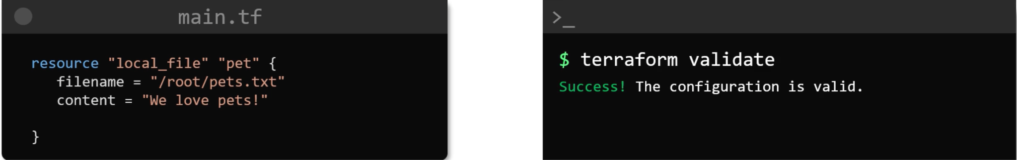
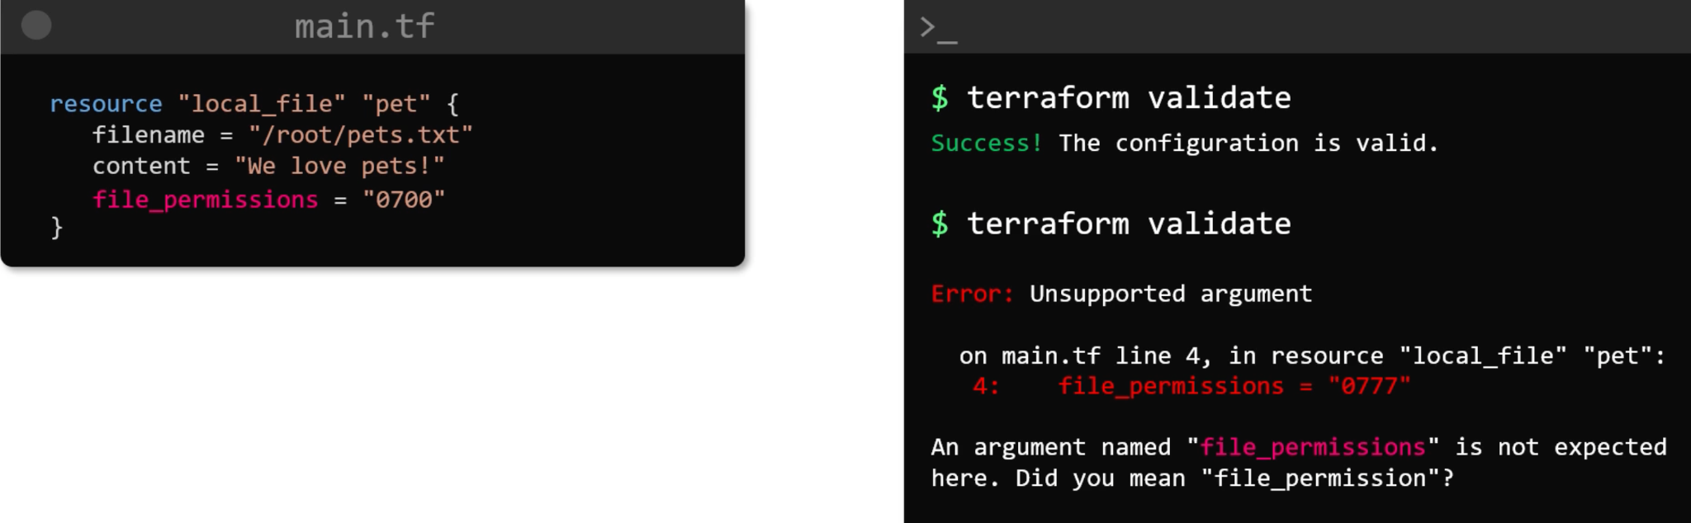
Terraform Commands
terraform validate

Slide 37
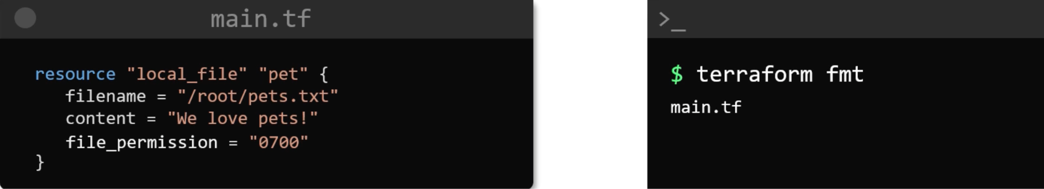
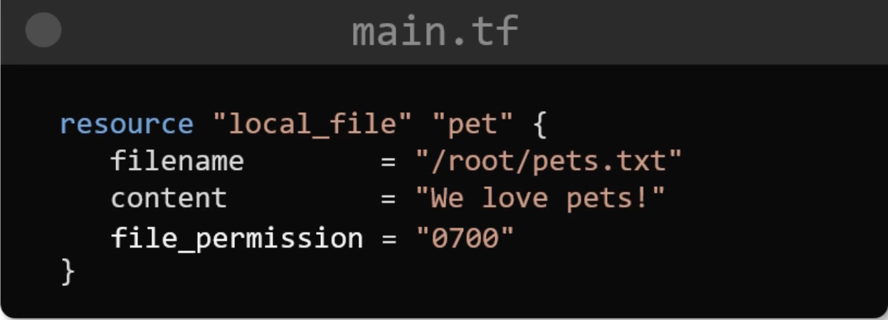
Terraform Commands
terraform fmt

Slide 38
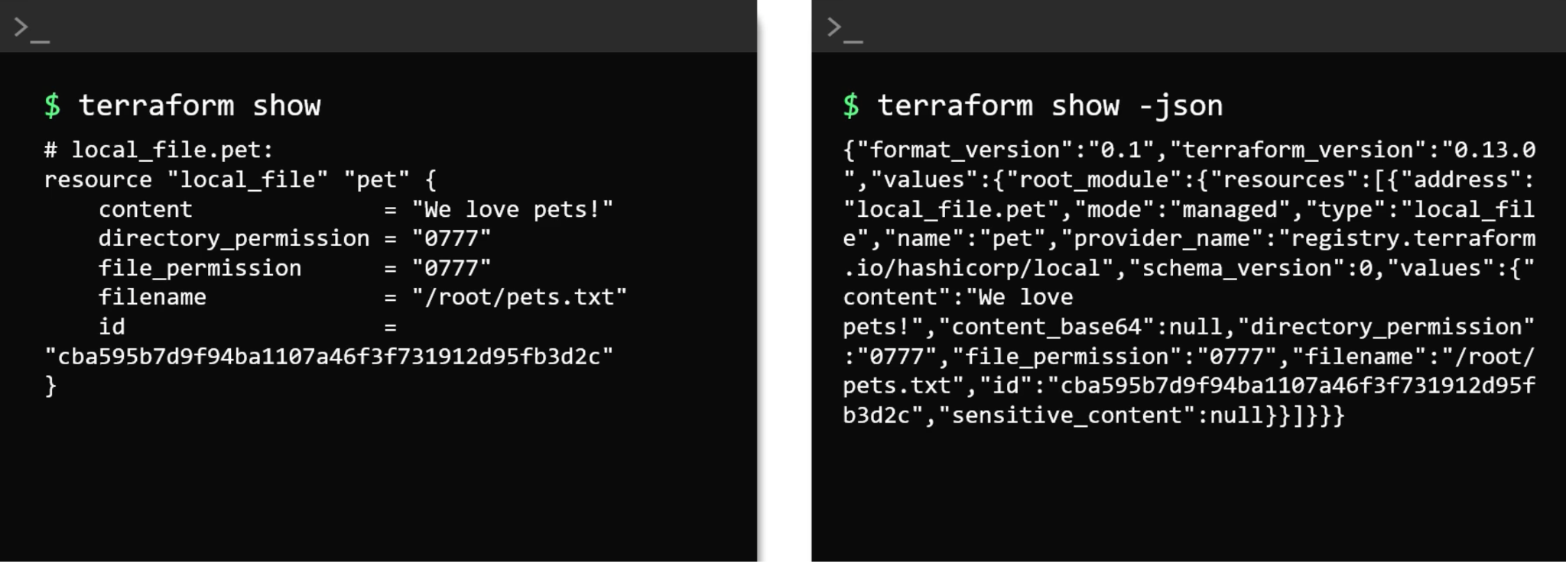
Terraform Commands
terraform show

Slide 39
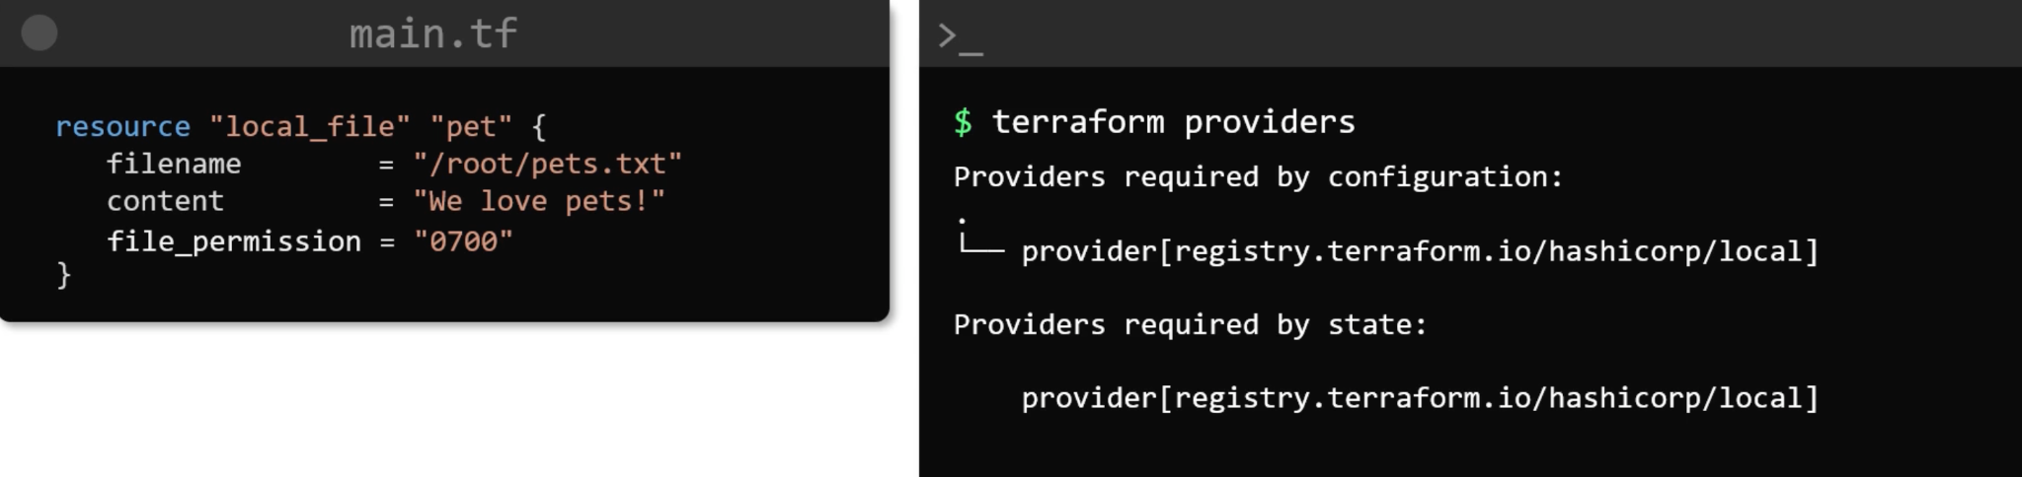
Terraform Commands
terraform providers

Slide 40

Terraform Commands
terraform output

Slide 41

Terraform Commands
terraform refresh

Slide 42

Terraform Commands
terraform graph

Slide 43

LifeCycle Rules

Slide 44

LifeCycle Rules
create_before_destroy

Slide 45

LifeCycle Rules
prevent_destroy

Slide 46


LifeCycle Rules
ignore_changes

Slide 47

count and for each
count

Slide 48

count and for each
Length Function

Slide 49

count and for each
Length Function

Slide 50

count and for each
for_each

Slide 51

count and for each
for_each

Slide 52


Resource Dependencies
Implicit and Explicit Dependency

Slide 53

Datasources

Slide 54


Version Constraints

Slide 55


Version Constraints

Slide 56


Version Constraints

Slide 57


Version Constraints

Slide 58

What is Remote State and State Locking?

Slide 59


What is Remote State and State Locking?

Slide 60

What is Remote State and State Locking?

Slide 61

What is Remote State and State Locking?

Slide 62


What is Remote State and State Locking?

Slide 63

What is Remote State and State Locking?

Slide 64

Remote Backends

Slide 65

Remote Backends

Slide 66


Remote Backends

Slide 67

Terraform Provisioners
Remote Exec

Slide 68

Terraform Provisioners
Remote Exec

Slide 69

Terraform Provisioners
Local Exec

Slide 70


Terraform Provisioners
Time Provisioner

Slide 71

Terraform Provisioners
Fail Behaviour

Slide 72

Terraform Provisioners
Fail Behaviour

Slide 73

Terraform Provisioners
Data

Slide 74


What are modules?

Slide 75

What are modules?

Slide 76

What are modules?

Slide 77

What are modules?

Slide 78

Creating and Using a Module

Slide 79


Creating and Using a Module

Slide 80


Creating and Using a Module

Slide 81


Creating and Using a Module

Slide 82

Creating and Using a Module

Slide 83

Creating and Using a Module

Slide 84

Using Modules from the Registry

Slide 85

Using Modules from the Registry

Slide 86

Using Modules from the Registry

Slide 87

Using Modules from the Registry

Slide 88

Using Modules from the Registry

Slide 89

Terraform Import

Slide 90

Publishing Module

Slide 91

Publishing Module

Slide 92

Terraform Workspace

Slide 93

Terraform Workspace

Slide 94

Terraform Workspace

Slide 95



Terraform Workspace

Slide 96

Terraform Workspace

Slide 97




DİNLEDİĞİNİZ İÇİN TEŞEKKÜR EDERİZ
www.hepapi.com
info@hepapi.com
284 Chase Road, London, N14 6HF, United Kingdom
Büyükdere Caddesi No:199, Levent 199, 34330 İstanbul, Turkey

